Slide 2
Home Care Category
Hyvest comes from the core words Hygiene and Vestige
HYGENIUS SOLUTIONS from VESTIGE
Home Hygiene promotes good health and overall wellness for your entire family

Slide 3
Your home hygiene assistant helps you to provide continuous protection of your loved ones against everyday illnesses.
Germs enter our homes, through people (who may have an infection or are carriers of germs), contaminated food, domestic animals, and sometimes through water or via air.
Good hygiene plays an important part in reducing the burden of infectious diseases in our homes and also prevents them from spreading.

Slide 4
Home Hygiene
Germs can be found everywhere
They can survive on hard surfaces such as floors, doorknobs, handrails etc. for about 24 hours
On soft surfaces such as fabric furniture and beddings, they can survive for 20 – 30 minutes
If the germs aren't allowed into the home, it is easier to protect your family
A clean home would prevent illness before it begins
It would also prevent the spread of disease if practiced on a day to day basis

Slide 5
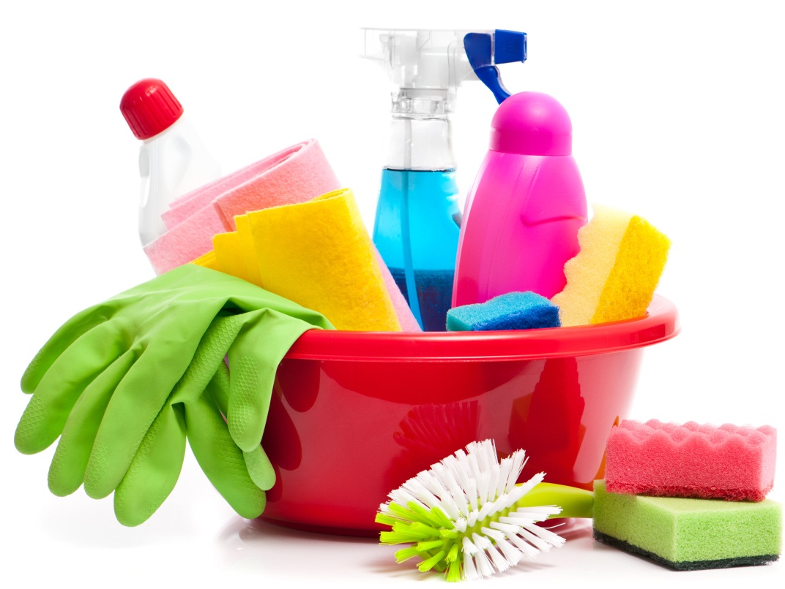
Daily Protection
Maintaining cleanliness at home is not just a “do it and forget it” activity
It should be in the daily to-do list of every household for healthy living
What to do to keeps germs at bay –
Clean the dust
Keep flies away
Remove garbage everyday
Keep the bathroom clean and dry
Allow sunlight into the rooms
Ventilate the rooms
Keep kitchen clean and hygienic at all times

Slide 8
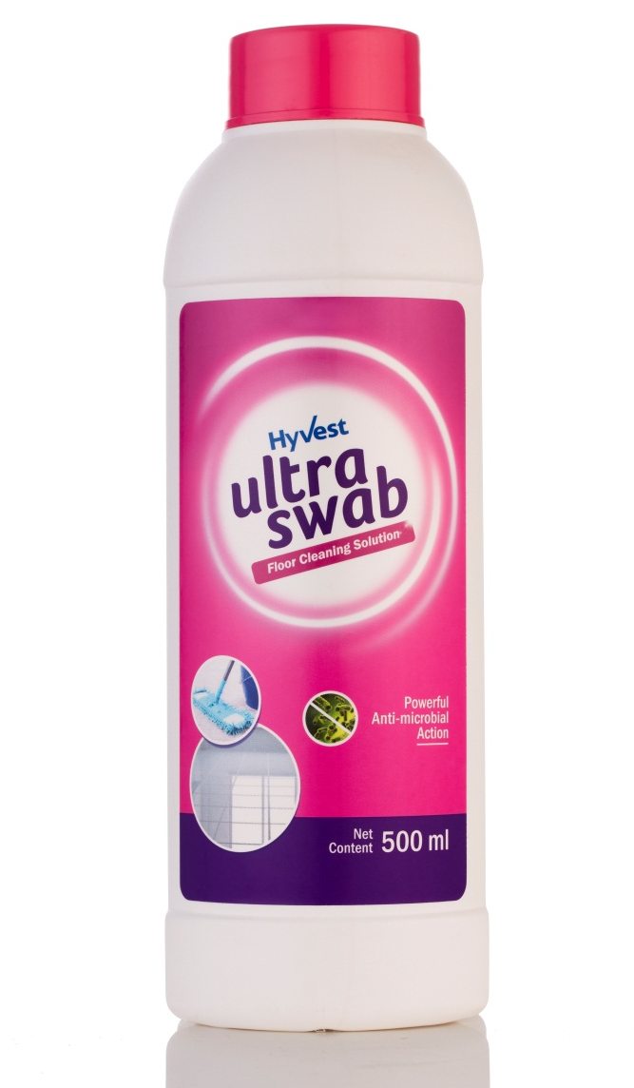
Ultraswab – Floor Cleaning Solution
Concentrated formula for daily cleaning and mopping
It gives total germ protection by killing 99.9% of germs including bacteria, virus and fungus
Effectively removes tough stains, dirt and grime from all kind of household surfaces

Slide 9
Ultraswab – Floor Cleaning Solution
Leaves the mopped area refreshingly clean with a long lasting floral fragrance
Contains Benzalkonium Chloride solution that disinfects any surface completely

Slide 10
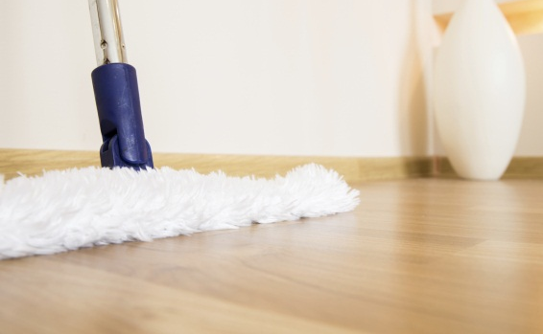
Ultraswab – Floor Cleaning Solution
USE ON:
All types of floors & surfaces:
Marble
Mosaic
Wooden
Granite
Ceramic, etc.
Kitchen countertops
Tiles
Bathroom floors etc.
FOR REGULAR USE: Floor Mopping
Use half capful of concentrate in one forth bucket of water (4 L)
Gently wipe using a mop. No need to rinse.
KITCHEN SURFACE:
Use undiluted for tough stains, or diluted for regular cleaning
Use a kitchen towel for best results

Slide 11
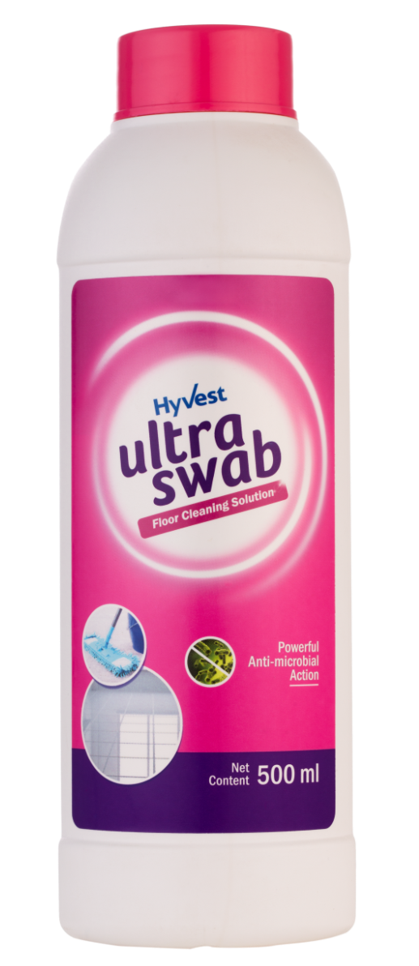
Ultrawash – Floor Cleaning Solution
Concentrated Formula
Kills 99.9% germs
Gives total germ protection
Removes tough stains
Cuts through dirt and grime
Refreshing and lasting fragrance

Slide 12
Ultraswab – Floor Cleaning Solution
MRP : 23.00 SAR
DP : 19.55 SAR
PV : 6.36

Slide 13
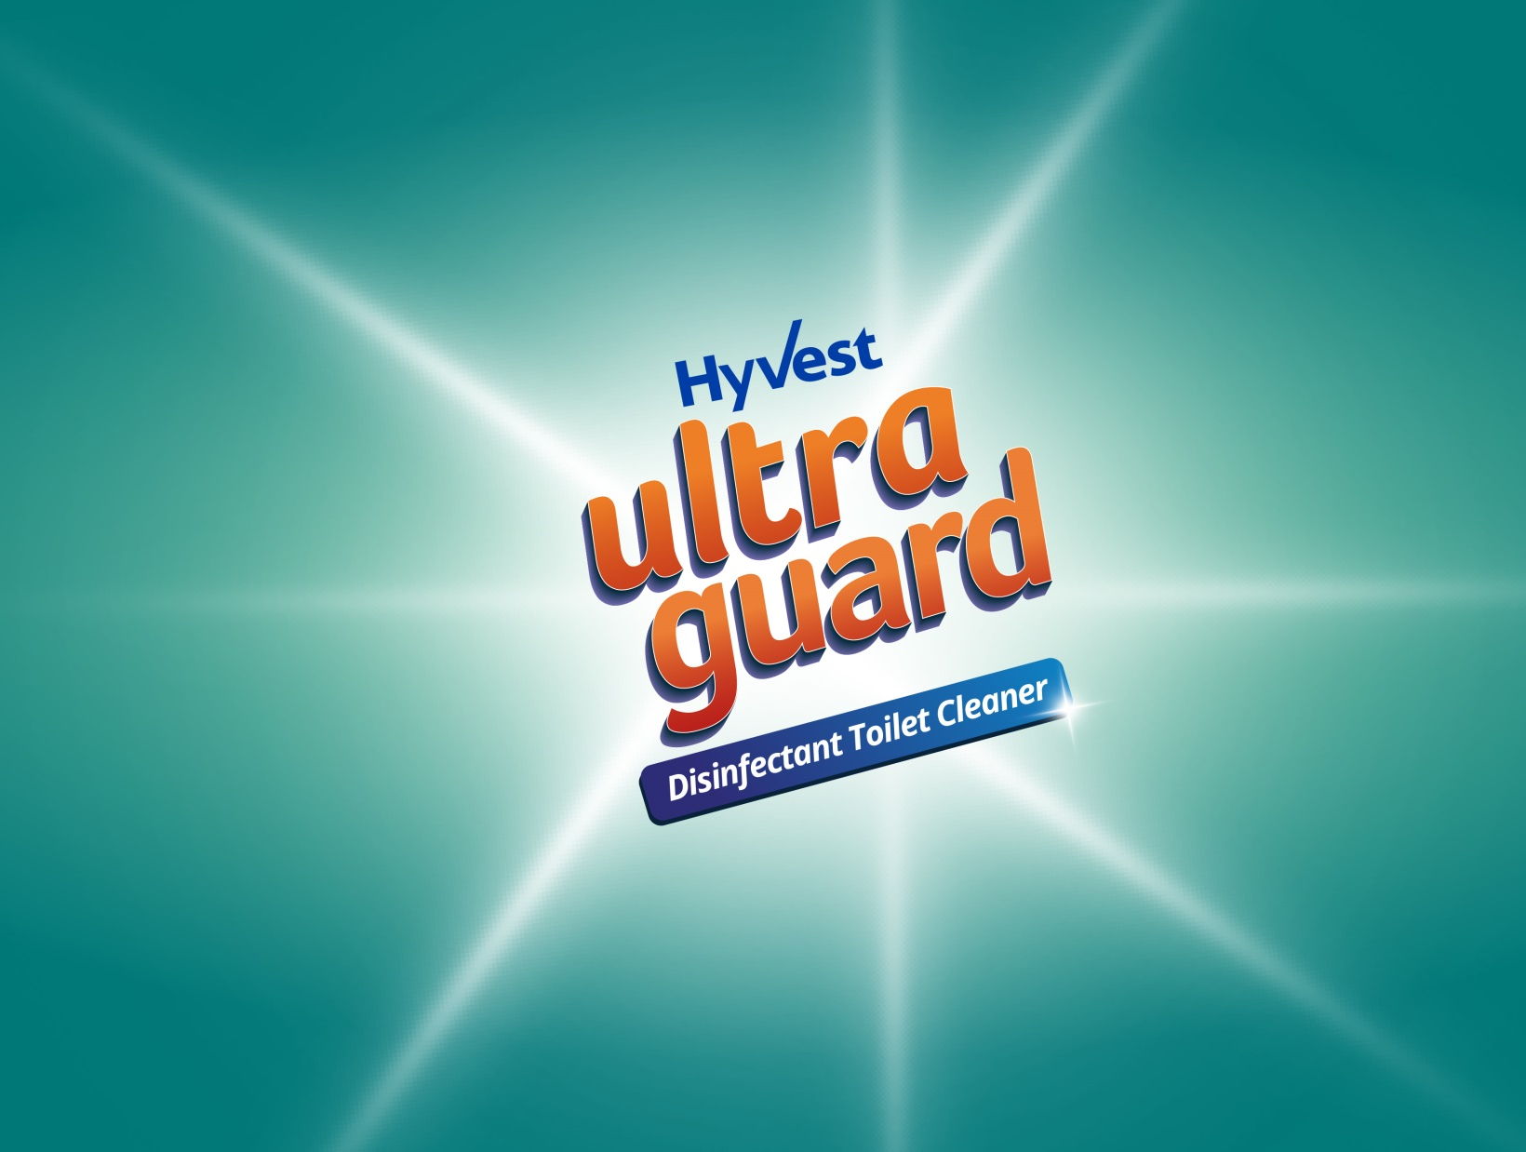

Slide 14
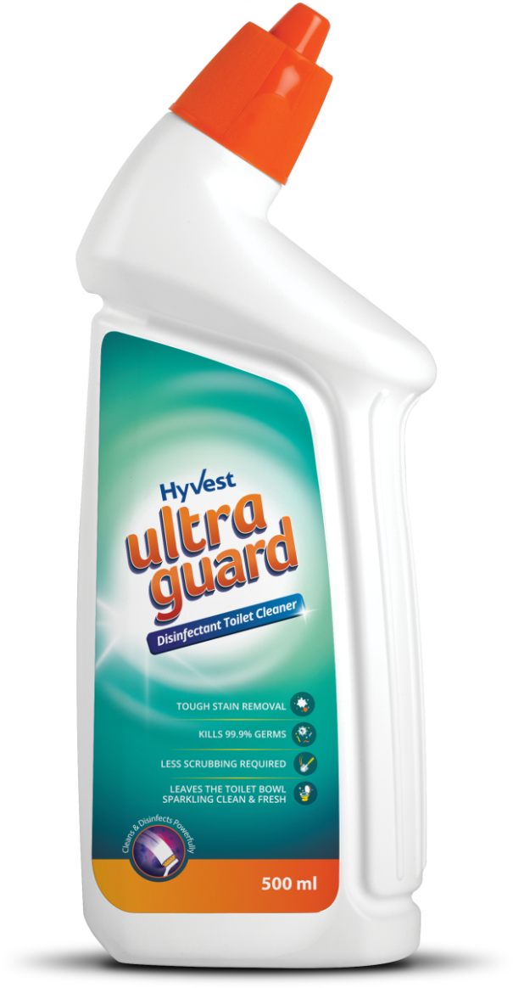
Ultra Guard– Disinfectant Toilet Cleaner
Hyvest Ultra Guard is an advanced thicker formula that powerfully cleans by killing 99.9% germs and disinfects the toilet
It clings to the toilet surface to clean deeply from the rim to the U-bend
It effectively dissolves toughest stains, lime scale build-up and residues, leaving behind sparkling clean bathroom with a refreshing fragrance

Slide 15
Ultra Guard– Disinfectant Toilet Cleaner
Regular use of Hyvest Ultra Guard prevents the build-up of stains in the toilet bowl and keeps it visibly clean with effective germ removal
Hyvest Ultra Guard’s strategically bent bottleneck shape lets you pour the liquid into deep corners under the toilet rim, without letting your hands touch giving you all round cleaning

Slide 16
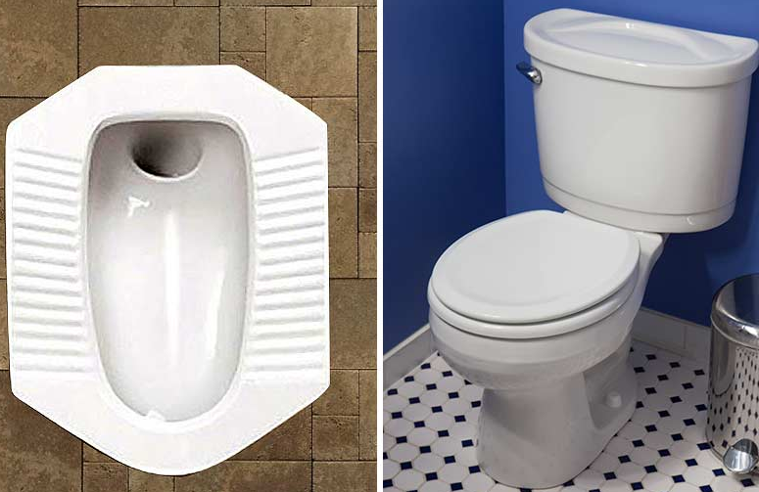
Clean Toilet– Importance
The toilet is certainly one of the most important parts of our household
In toilet there are widespread of bacteria which may cause many disease and infections
Using dirty toilets may cause infections like UTI
It is advised to disinfect your toilet twice a week

Slide 17
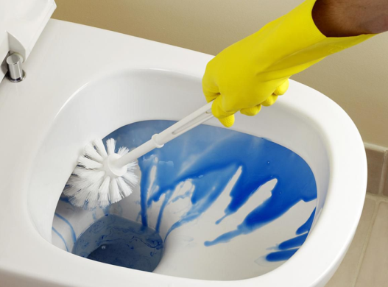
Ultra Guard– Benefits
Helps fight odour & unpleasant smell
Provides tough stain removal
Kills 99.9% germs
Less scrubbing required while cleaning
It leaves the toilet bowl sparkling clean & fresh
Regular use of Hyvest Ultra Guard toilet cleaner prevents the build-up of stains in the toilet bowl & keeps it visibly clean with effective removal of germs in the toilet

Slide 18
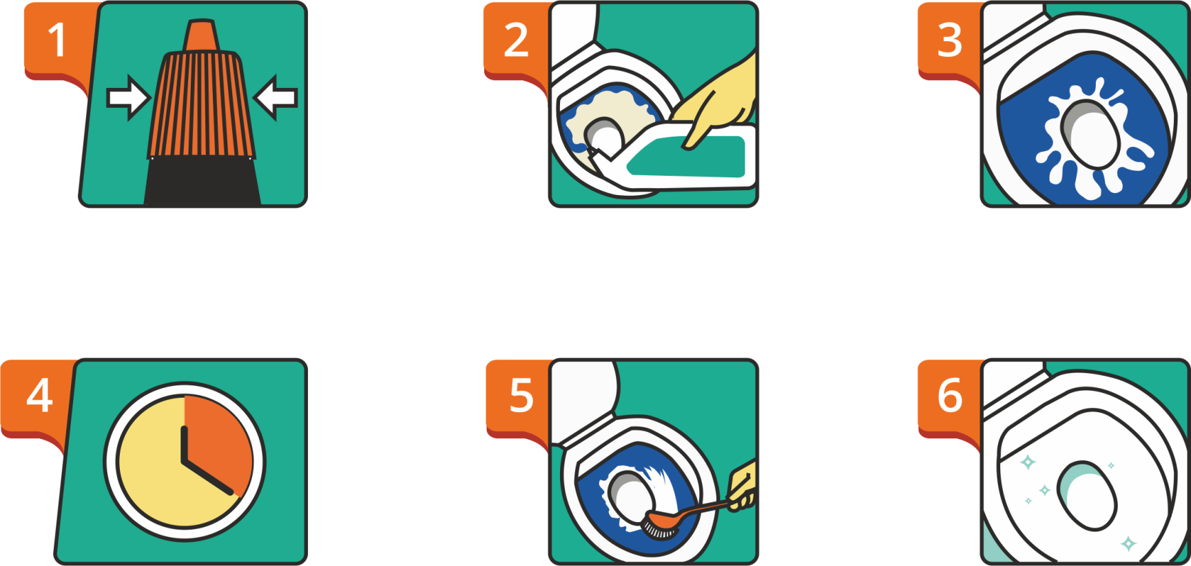
Ultra Guard– Directions to Use
Press & twist to open the cap
Apply liquid under the rim
Let the liquid spread
Wait for 20 minutes
Brush lightly & flush
Sparkling & Clean toilet

Slide 19
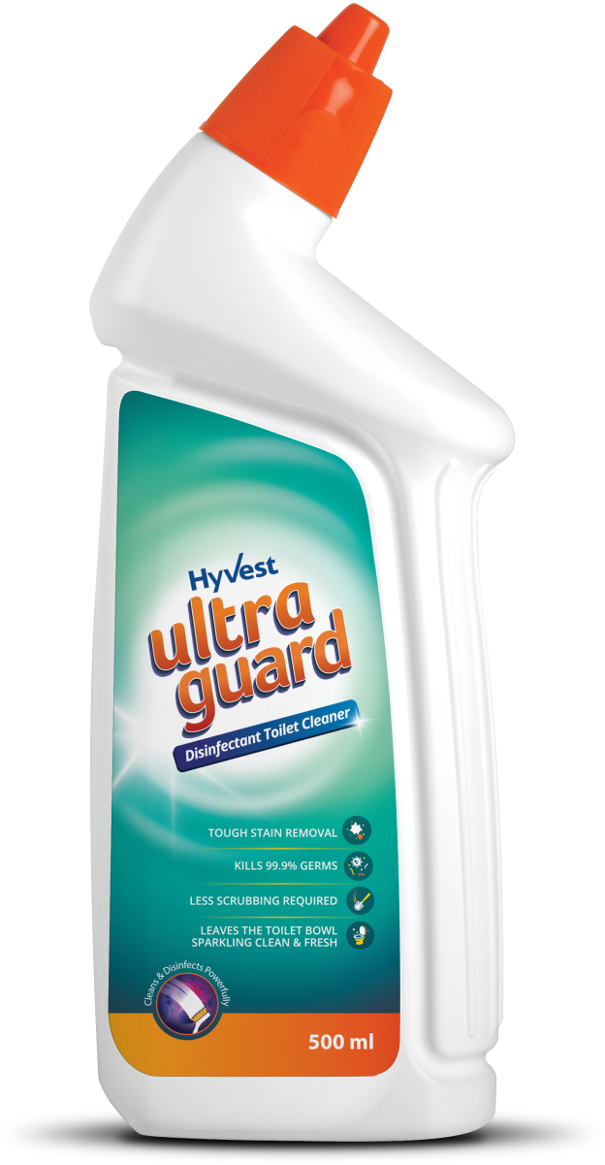
Ultra Guard– Disinfectant Toilet Cleaner
MRP : 13.80 SAR
DP : 11.50 SAR PV : 3.74

Slide 20
THANK YOU

