Slide 1


Slide 2
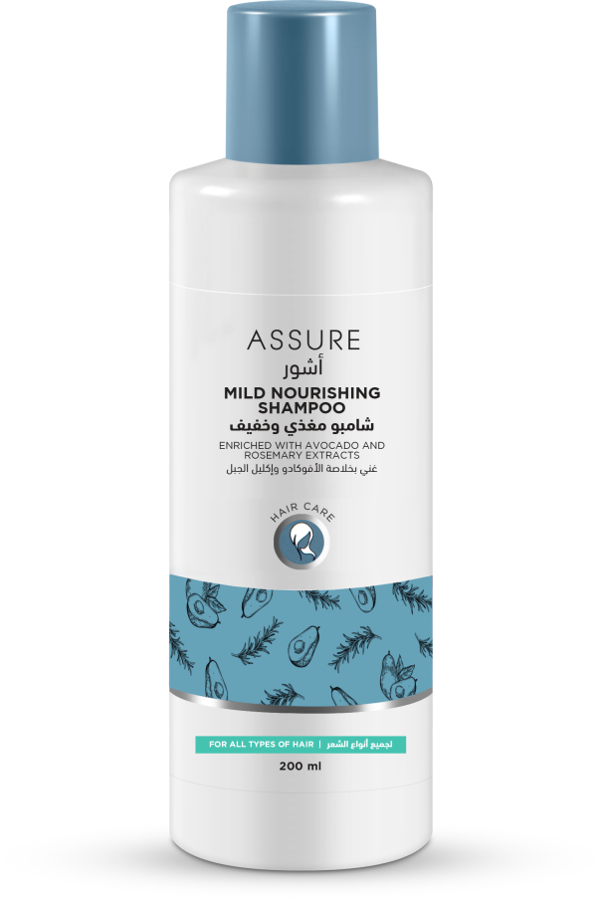
ASSURE Mild Nourishing SHAMPOO
Shampooing everyday can strip the hair off essential moisture produced by the scalp making it prone to damage and flakes
This shampoo helps maintain the moisture balance in the hair and scalp

Slide 3
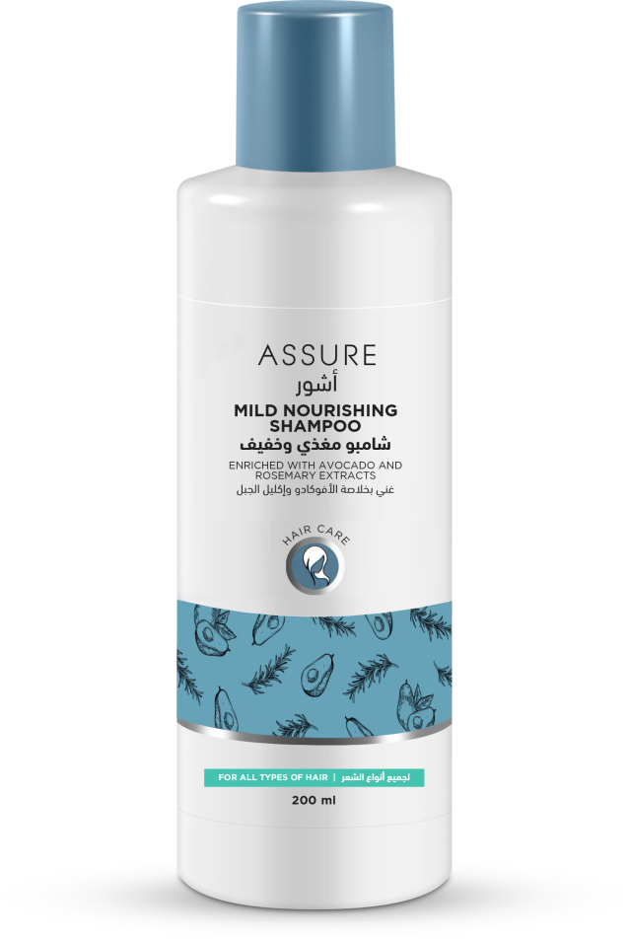
ASSURE Mild Nourishing SHAMPOO
It adds extra bounce to the hair leaving it glossy smooth and healthy
Enriched with Avocado Oil and Rosemary that sufficiently hydrates the hair and scalp and repairs split ends
Ideal for everyday use and suitable for all hair types

Slide 4
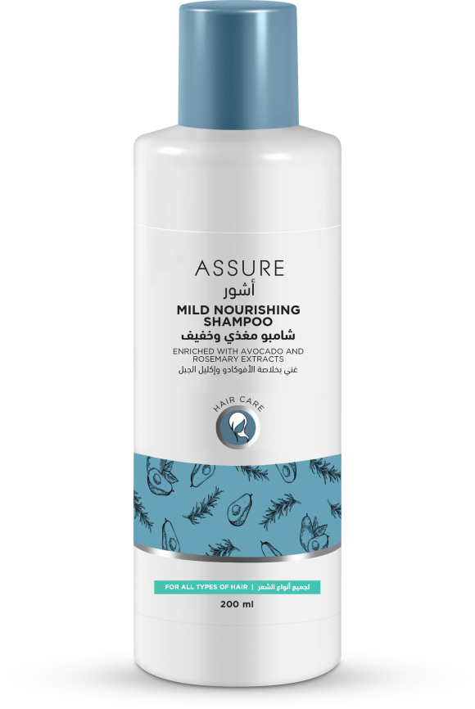
Product Features
2
It’s natural extracts helps to manage moisture level without striping off hair natural oils
1
A gentle hair cleanser that keeps hair healthy.
4
Leaves hair strong, shiny and beautiful.
3
Extra bounce & promotes hair growth.

Slide 5
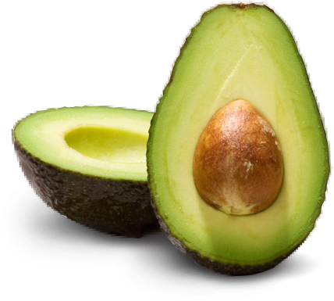
Avocado Oil extract Rejuvenate and moisturize the scalp.
A rich source of proteins,
amino acids and vitamins,
Soothe the scalp and
promotes long, strong,
healthy hair growth.

Slide 6

Rosemary extract
Improves blood circulation to the scalp which encourages growth.
Nutrients to hair follicles for healthy hair growth.

Slide 7
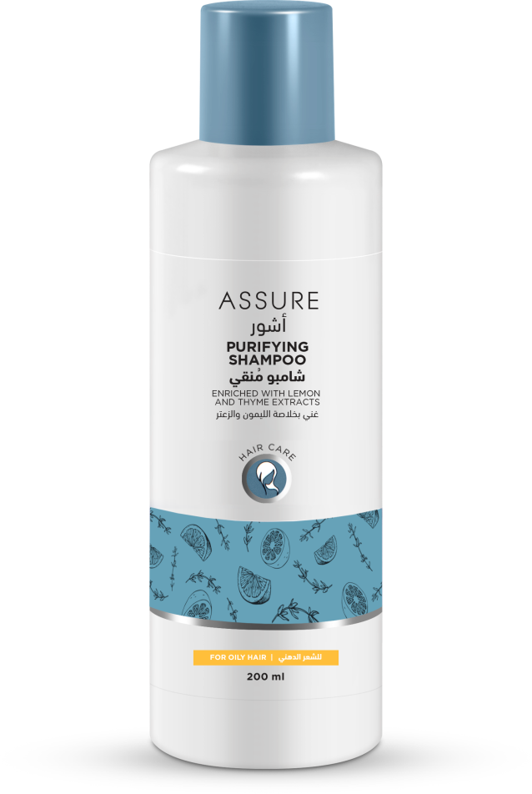
ASSURE purifying SHAMPOO
  Thinning hair often starts at the scalp when hair follicles become clogged by sebum or fatty acids
  Assure Purifying Shampoo is enriched with Lemon and Thyme Extract
This shampoo reduce excess controls sebum secretion and encourages healthy hair growth
A special herbal complex with Lemon and Thyme Extracts nourishes the hair while adding body and sheen
Ideal for oily scalp and suitable for oily hair types

Slide 8

Product Features
2
Keeps the hair clean and fresh throughout the day.
1
Deeply cleanse the hair.
4
No scalp odour.
3
Helps to remove dandruff, excess oil.

Slide 9

Lemon extract
Lemons can be your one-stop solution to all your hair woes- hair loss, dandruff, oily scalp.
It also stimulates hair follicles, which encourages hair growth.

Slide 10
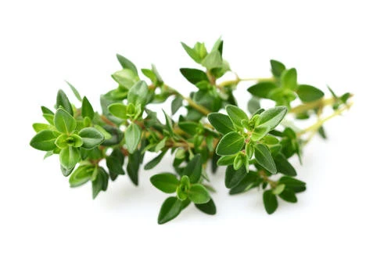
Thyme extract
Thyme can help promote hair growth by both stimulating the scalp and actively preventing hair loss.

Slide 11
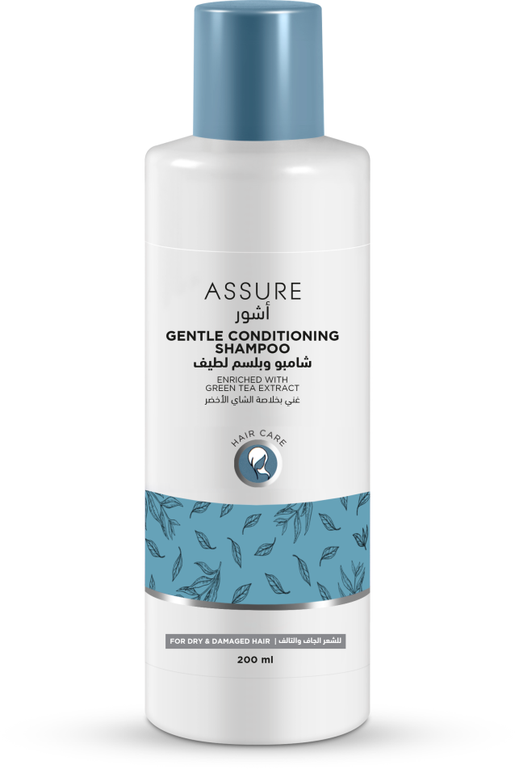
ASSURE Gentle conditioning SHAMPOO
Extreme heat, cold, sun exposure / chemicals / poor diet can leave hair dry, brittle and damaged
Enriched with Green Tea Extract, which refreshes the hair and scalp, as it cleanses, soothes, restores dry hair and repairs split-ends
Milk protein moisturizes and conditions the hair without weighing it down
Suitable for dry and damaged hair types

Slide 12

Product Features
2
Repairs split-ends
1
Nourishing, strengthening and moisturising from root to tip.
4
Conditions the hair without weighing it down
3
Gently cleanse dry and damage hair

Slide 13
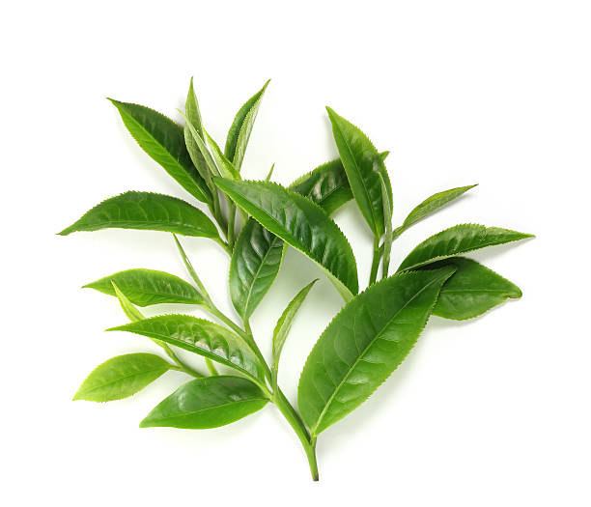
Green Tea extract
It can protect your follicles against free radical damage. It can stimulate hair regrowth.

Slide 14


