Slide 2
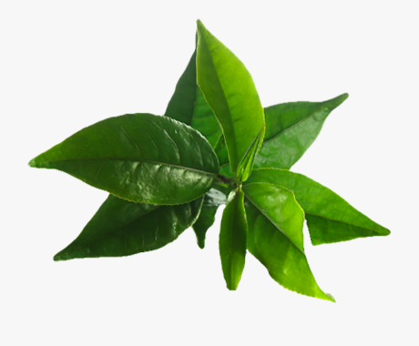
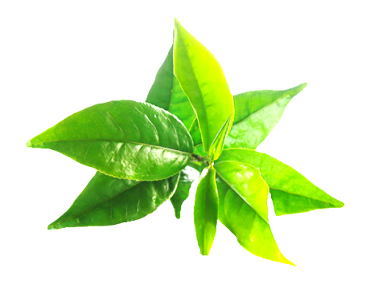
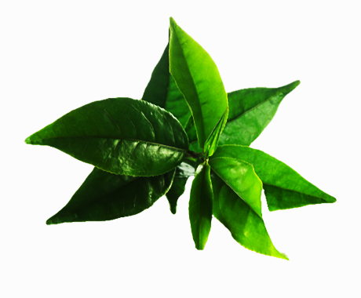
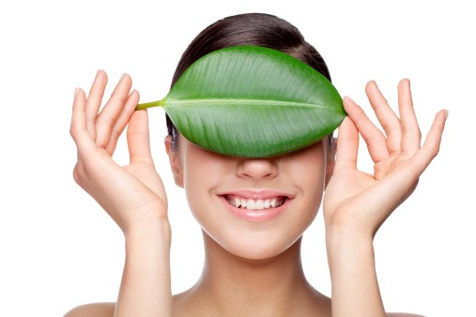
What is Assure Natural …
Assure Natural is an advanced formulation natural personal care range. The products of this range are made with ethically-sourced natural ingredients keeping your body and the environment in mind.

Slide 3
Key pillars of Assure Natural
Noble purpose
Exotic ingredients
Evolving category trends
Ethically right products :
Vegan
Sulphate- free
Paraben-free
PETA certified
World class ingredients
Honest to skin
Environment-friendly
Advanced formulations
International trends
Evolving global consumer trends

Slide 4
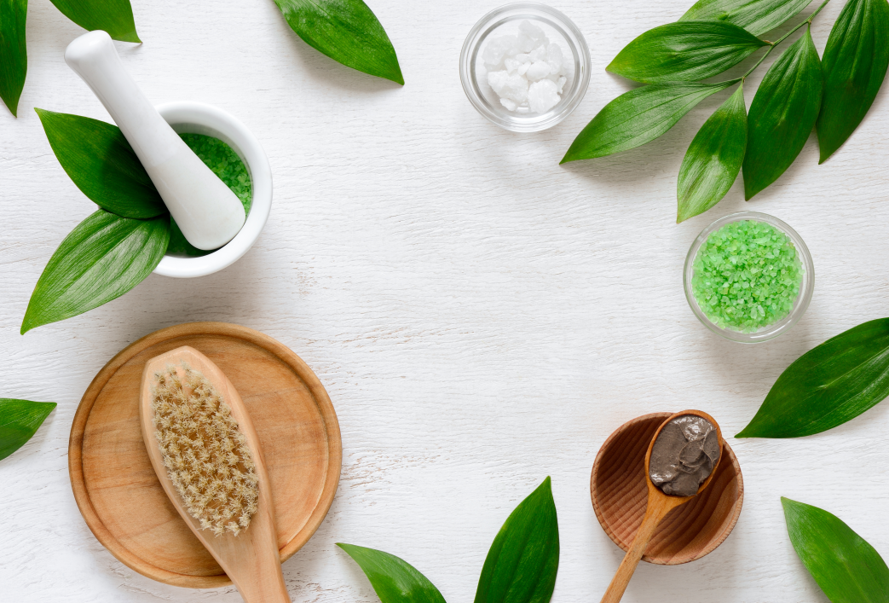
The Assure products are:
Caring
Gentle
Effective

Slide 6
Get ready to work a whole new kind of cleanser into your routine.
Micellar Water is the facial cleanser that has been the best-kept beauty secret and touted for its ability to act as both a makeup remover and a facial cleanser.

Slide 7
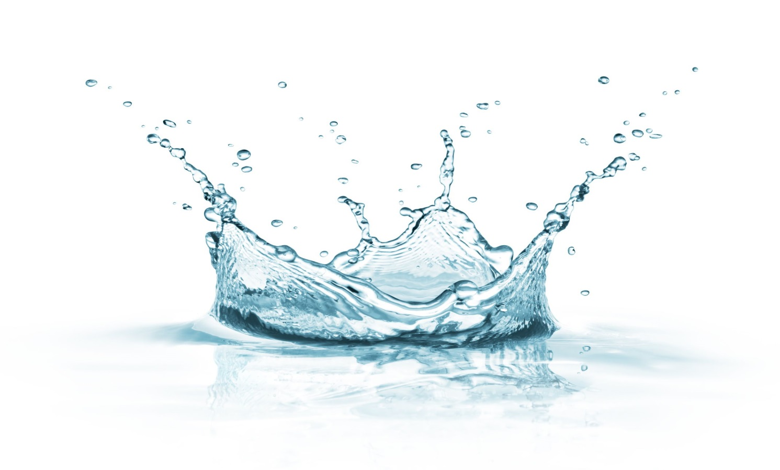
Micellar Water is quite the multitasking genius—it works as a face wash, a makeup remover and a hydrator since it balances out the moisture in your skin.

Slide 8
MICELLAR WATER IS NOT SOME SORT OF PROCESSED TAP WATER. THEN WHAT IS MICELLAR WATER MADE OF?
Micellar water is made of micelles—minuscule concentrated molecules—that are both water-loving and oil-loving. This implies that these micelles have the ability to gobble up grime and excess oil from the skin.
Micelles pretty much work like magnets, in that they attract and trap the dirt and excess oils on your skin.
This is why the water removes makeup, grime and cleanses your skin.

Slide 9
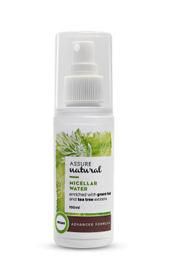
ASSURE NATURAL MICELLAR WATER
Assure Natural Micellar Water is a 3-in-1 product which quickly and completely wipes off makeup, cleanse skin by removing dirt and oil from pores and its green tea and tea tree extracts helps control acne and leaves the skin hydrated and revitalised.

Slide 10
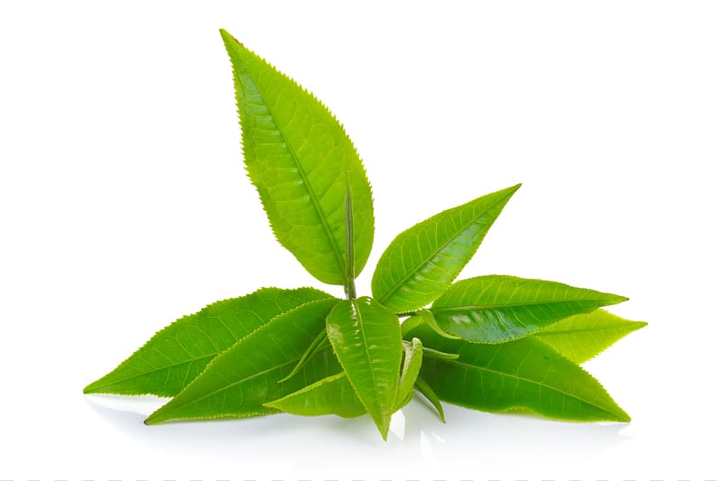
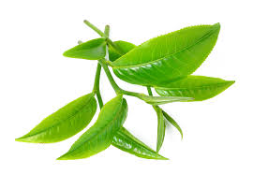
Assure Natural Micellar Water is enriched with green tea leaf extract and tea tree leaf extract.
Green tea leaf extract :
Reduces irritation, redness and swelling.
Rich in antioxidants and gives anti-ageing effect.
Provides hydration and nourishment.
Tea tree leaf extract:
Promotes glowing skin
Moisturises and restores the skin’s natural oil balance

Slide 11
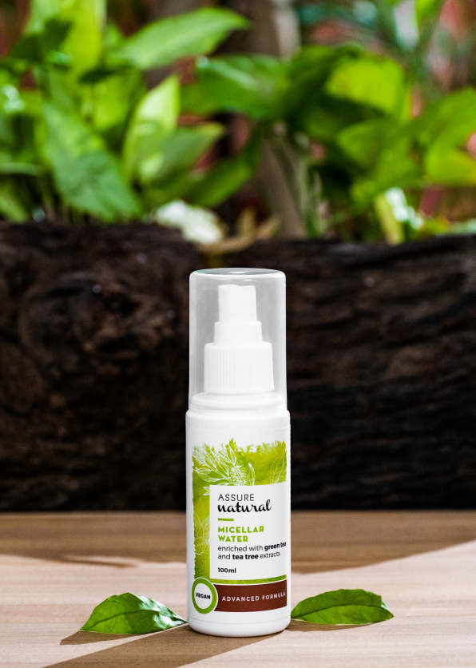
ASSURE NATURAL MICELLAR WATER
MRP – 28.75 SAR
DP - 24.15 SAR
PV - 7.85

Slide 12
Thank you

