Slide 1
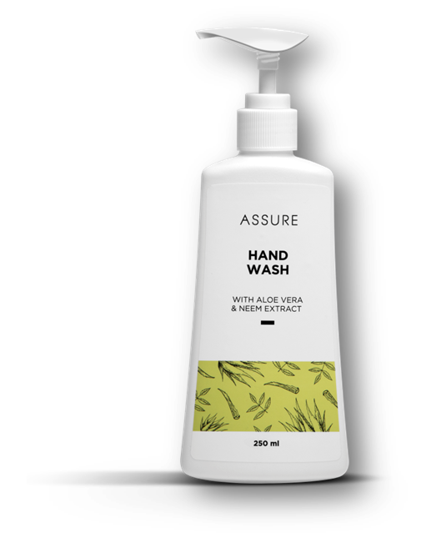
Introducing! ASSURE HAND WASH

Slide 2
ASSURE HAND WASH
Introducing! A mild yet effective hand wash for the gentle care of your hands.
Enriched with Neem and Aloe Vera extracts, it provides gentle protection and moisturisation without drying out the skin.
Refreshing fragrance keeps the hands fresh for long.

Slide 3
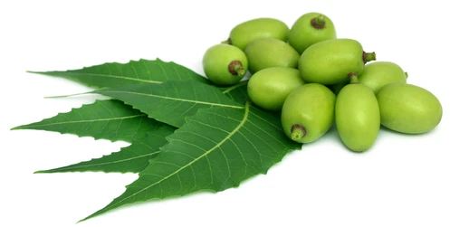
Neem Benefits
Neem have anti-bacterial properties
It destroys the bacteria that causes infections, stimulates the immune system and encourages rapid healing

Slide 4
Aleo Vera Benefits
Moisturise the irritated skin
Soothes dry skin
Protects from sun burn

Slide 5
ASSURE HAND WASH
MRP: 15.52
DP: 12.94
PV: 4.21

Slide 6
Thank you

