Slide 1

WELLNESS KIT

Slide 2

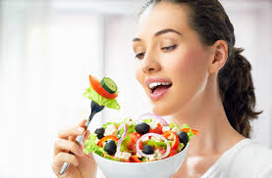

MAINTENANCE OF HEALTH
EXERCISE
FOOD
SLEEP
SLEEP

Slide 3
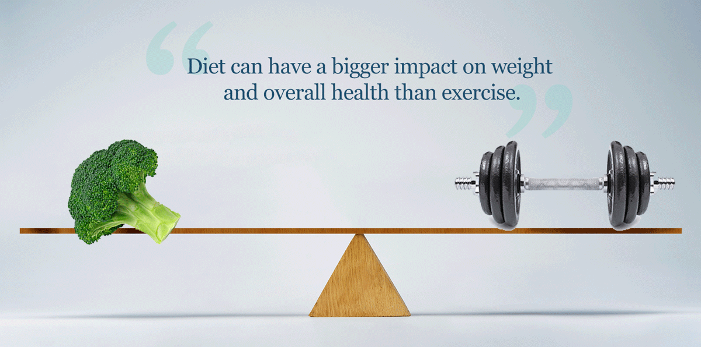
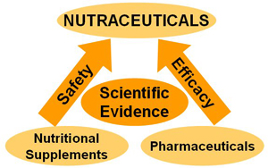
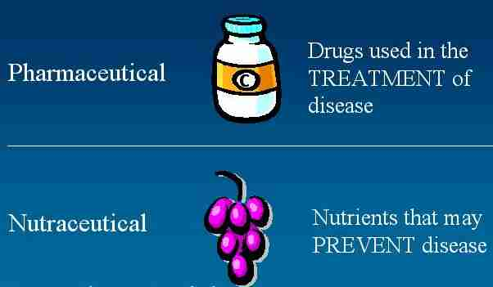
FOOD

Slide 4

SEA BUCKTHORN

Slide 5

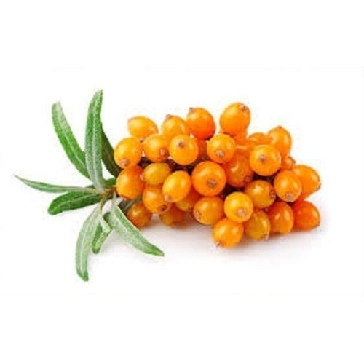
SEA BUCKTHORN
Over 190 bioactive compounds in one tiny berry
Carotenoids
Tocopherols
Flavonoids
Lipids
Ascorbic acid

Slide 6
SEA BUCKTHORN BENEFITS
Maintains high energy
Vitamin C and other nutrients helps to reduce headache, dizziness and increases mental attention
Wonderful Antioxidants to protect brain tissues from damaging effect of free radicals and toxins
Stamina building:
Vitamins help to reduce common symptoms like fatigue such as low energy and muscle tension and help in getting a sound sleep.
Cardiac benefits
Flavonoids may help to regulate blood pressure, improve heart function and reduce stress on heart tissue.
Skin benefits
Vitamin A, Vitamin E and Omega 7 fatty acids are considered essential nutrients for skin and they promote tissue and collagen regeneration, reduce skin wrinkles and premature skin ageing

Slide 7
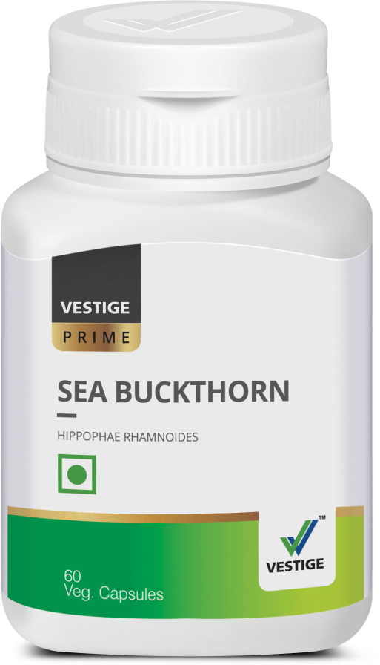
DOSAGE
One capsule twice a day after meals

Slide 8
FLAX OIL

Slide 9
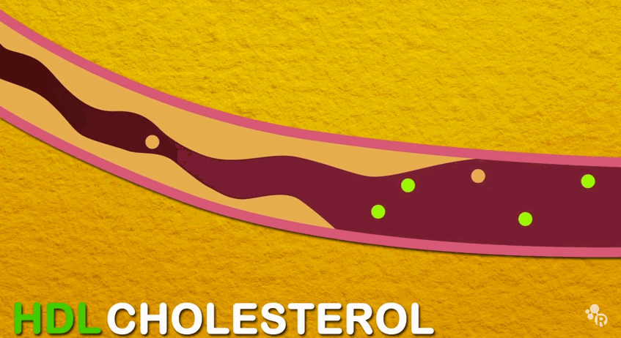

FLAXSEED OIL BENEFITS
Helps lower cholesterol & triglycerides
Prevents blockage of arteries
Helps prevent accumulation of fatty deposits inside blood vessels
Play a role in burning body fat
Aid in the growth of healthy hair and nails
Promote healthy skin
It helps to balance hormonal levels in women
It helps to regulate the menstrual cycle

Slide 10
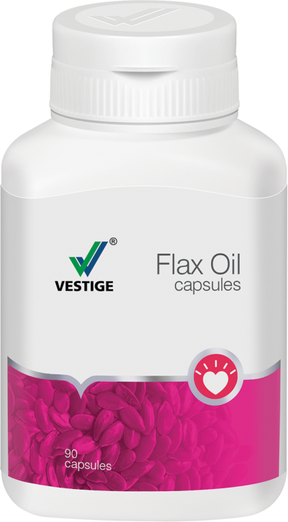
DOSAGE
Two to three capsules a day after meals

Slide 11
ALOEVERA

Slide 12

ALOEVERA & ITS NUTRITIONAL CONTENT
Minerals:
Calcium
Sodium
Iron
Potassium
Chromium
Magnesium
Manganese
Copper
Zinc
Vitamins:
Vitamins A
Vitamin B1,B2
Vitamin B6,B12
Vitamin C
Vitamin E
Folic Acid
Niacin
ALOEVERA= Healing + Soothing + Laxative + Rejuvenating properties

Slide 13
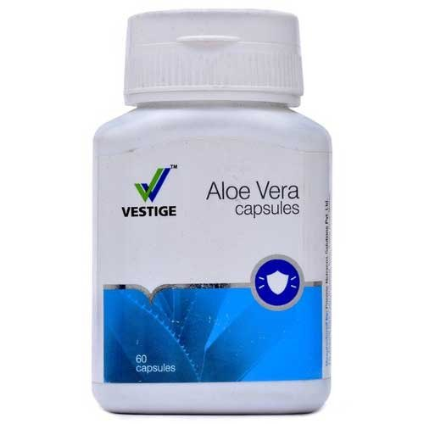
DOSAGE
One capsule twice a day empty stomach.

Slide 14
CALCIUM

Slide 15
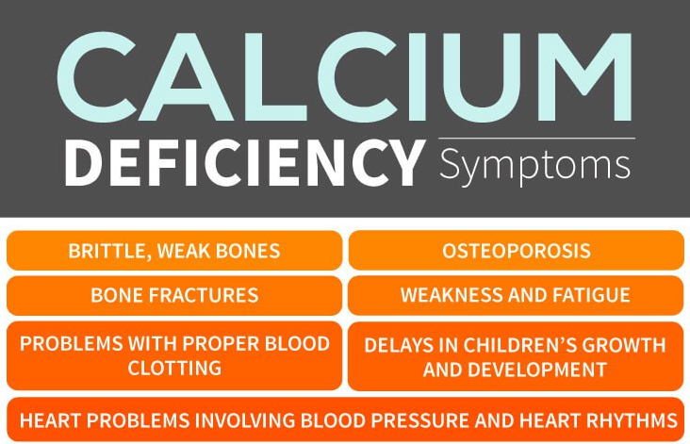

Slide 16
HOW TO KEEP BONES STRONG
Boost your Calcium Intake.
Include a good calcium supplement.
Enjoy Early Morning Sunlight
Avoid Excess Salt
Quit Smoking
Say No to Carbonated beverages
Drink Less Coffee

Slide 17
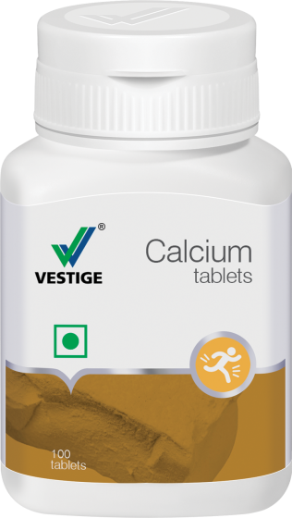
DOSAGE
One capsule twice a day after meals

Slide 18
INVIGO PROTEIN POWDER

Slide 19
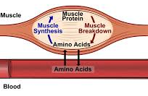

NEED OF PROTEIN
A vital source of nourishment for the body
Made up of amino acids that form the building blocks for the body’s growth
Plays a major role in development of cells and fluids in the body
Vital for the Growth + Repair + Maintenance of the body
Because of busy and stressful lifestyles, the body does not get enough protein in the diet
Protein Requirement= 1gm/kg IBW

Slide 20
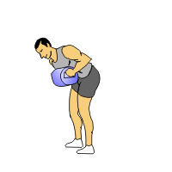
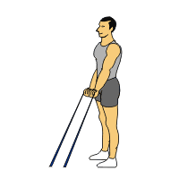
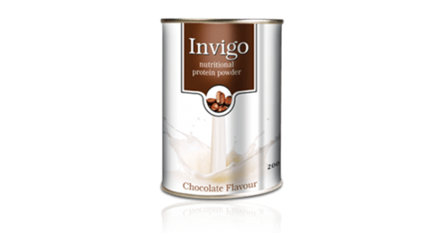
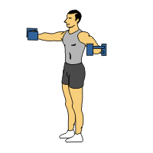
PROTEIN POWDER
A nutritional protein powder that is ideal for the entire family
Rich chocolate taste.
Low in fat & high in protein
Easy to digest

Slide 21
DOSAGE
One to two scoops daily with water or milk.

Slide 22
COLOSTRUM

Slide 23
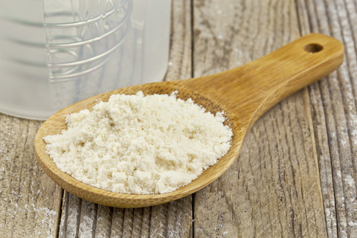
COLOSTRUM
CONTAINS -
37 Specific Immune Factors
5 Vital Immunoglobulin
Protease inhibitors
Over 8 types of Growth Factors
Growth Hormones
Major & Minor Vitamins
Minerals

Slide 24
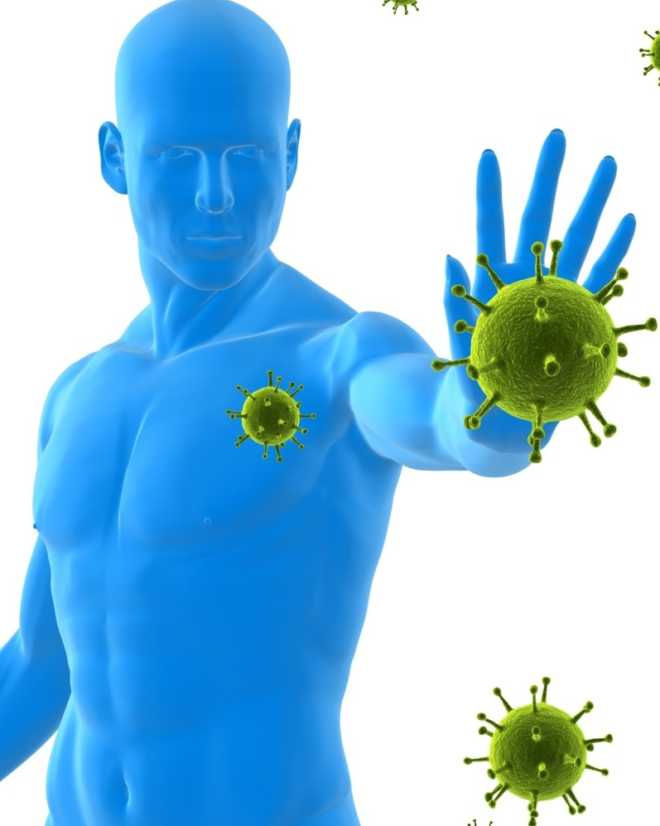
COLOSTRUM CAN BE HELPFUL IN
Helps to boosts the immune system of the body
Controls inflammation
Protects against allergic reactions
Helps to repair & rebuild cellular tissues
Helps to restores impaired health
Helps to improve nutrient uptake
Helps to increases bone mass
Restores skin elasticity
Energizes the body
Helps to increase memory
Normalizes the fat usage

Slide 25
DOSAGE
One to two capsules daily with water or milk.

Slide 26
What we get when we buy wellness set
Complete protection and balance nutrition for healthy living.
Sea buckthorn contains bioactive compounds to keep you healthy and active .
Invigo protein power comes with the goodness of chocolate and necessary macro nutrient for the body.
Aloe vera brings strong digestive system and create soothing and calming effect in body.
Calcium is essential for joints and bone health.
Flax is powerful source of omega 3 necessary for heart health and other wellness.
Colostrum is a powerful immunity booster.

Slide 27
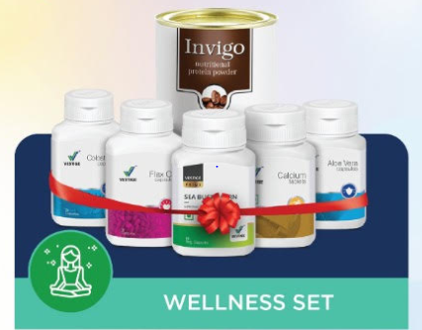
WELLNESS SET
wellness set provides you all the necessary products which helps to keep healthy and strong.
It is a powerful combination of different products which helps to create a strong body by providing all the necessary major nutrients.
When taken they boost the body health and ability to develop and grow better.
A set with complete protection and benefits.

Slide 28
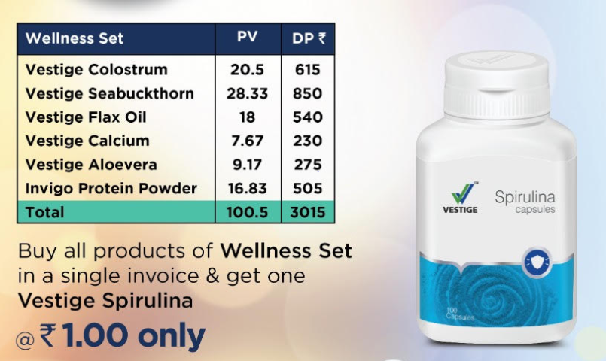
wellness kit

Slide 29
THANK YOU

