Slide 1
HYGIENE SET

Slide 2
IMPORTANCE OF HYGIENE
Good hygiene is vital because it helps prevent you and your children from getting or spreading germs and Infectious diseases.
Cleaning and disinfecting high-touch surfaces in your home regularly is an important precaution to lower the risk of infection.
Simple hygiene measures can help protect your family’s health and everyone else's.

Slide 3
ULTRA SWAB

Slide 4
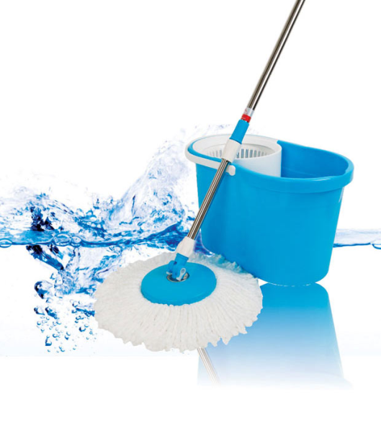
ULTRA SWAB
• Concentrated formula for daily cleaning and mopping with unique formula that gives total germ protection to your loved ones
• Kills 99.9% of germs including bacteria, virus and fungus, on floors and surfaces
• Effectively removes tough stains, dirt and grime from all kinds of household surfaces
• Leaves the mopped area refreshingly clean with its long lasting fragrance

Slide 5
ULTRA GUARD

Slide 6
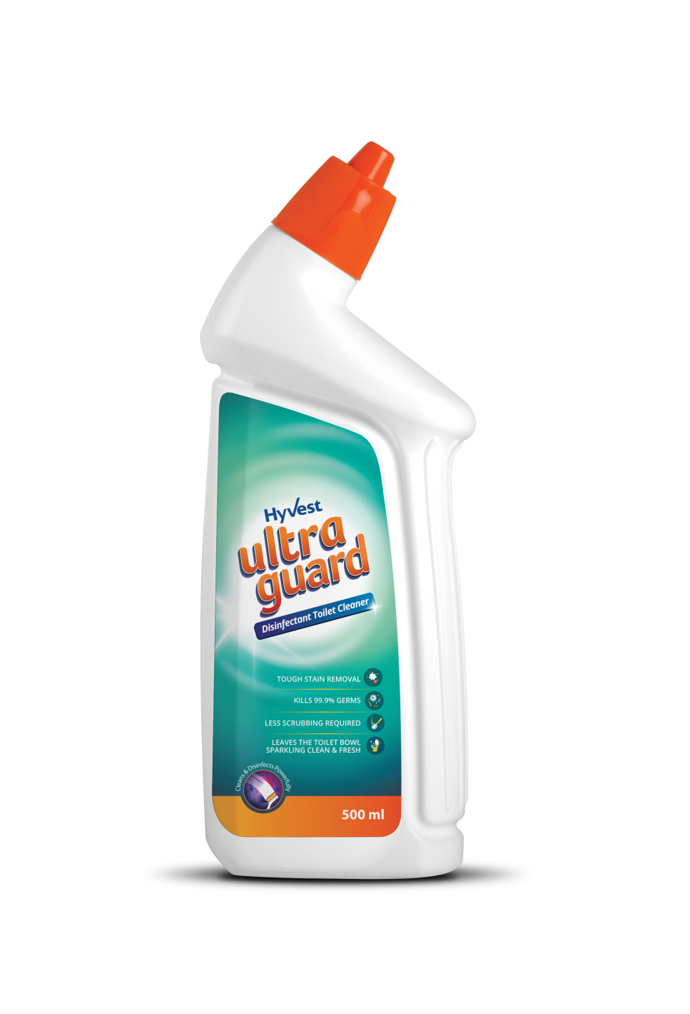
ULTRA GUARD
An advanced thick formula that powerfully cleans and disinfects the toilet
It effectively dissolves toughest stains, lime scale build-up and residues
Leaves your bathroom sparkling clean and with a refreshing fragrance
Regular use prevents the build-up of stains in the toilet bowl and keeps it visibly clean

Slide 7
ULTRA SHIELD

Slide 8
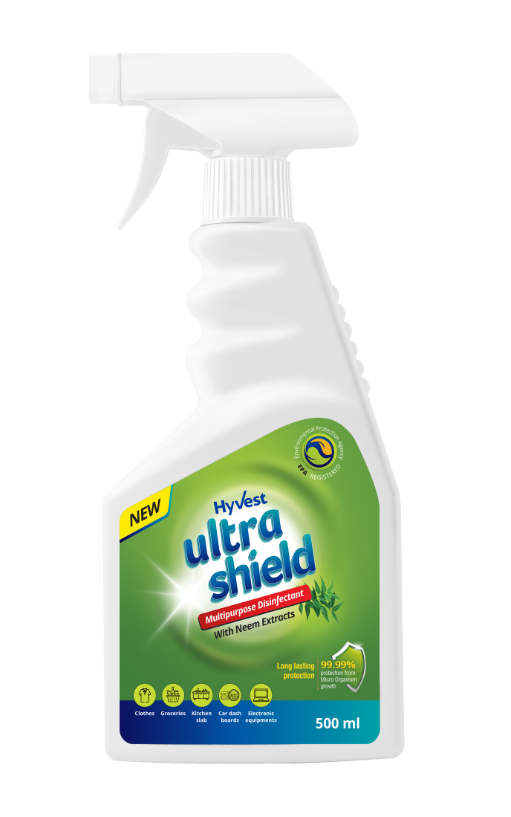
ULTRA SHIELD
A revolutionary water-based disinfectant, with the disinfecting power of neem extract, that makes a unique bond with any surface that comes in its contact.
Forms a antimicrobial coating on the surface and prevent a wide array of bacteria, mold, fungus, algae and yeast growth.
Can be applied to any surface, porous or nonporous, including fabrics, mattresses, curtains, carpets, kitchen or bathroom slabs, furniture, walls, floor, etc.
Non-toxic, non-hazardous and non-leaching.
EPA registered
99.99% protection from microorganism growth for up to 15 days

Slide 9
HAND CLEANING GEL

Slide 10
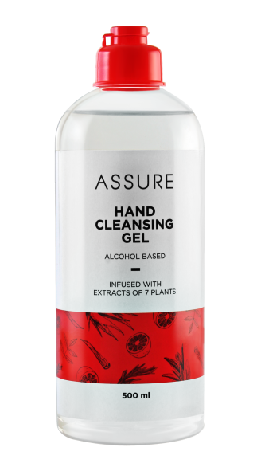
HAND CLEANING GEL
Assure Hand Cleansing Gel kills a wide range of germs instantly, without water.
Use anytime, anywhere while in a car, at office, when travelling, after playing, etc.
Leaves your hands clean and germ-free. Use as often as required.

Slide 11
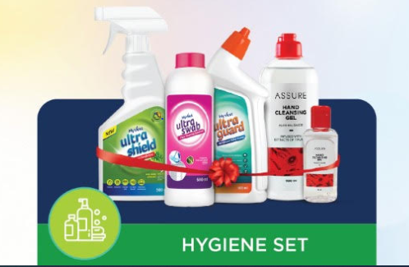
HYGIENE SET
Complete set provides you all the products in hygiene and safety category.
Hygiene is the need of the hour and our family need complete protection.
From hand cleaning gel to surface cleaner this kit have it all.
A complete package for those who love their families and want to keep them healthy and safe.

Slide 12
HYGIENE SET

Slide 13
THANK YOU

