Slide 1

IMMUNITY SET

Slide 2
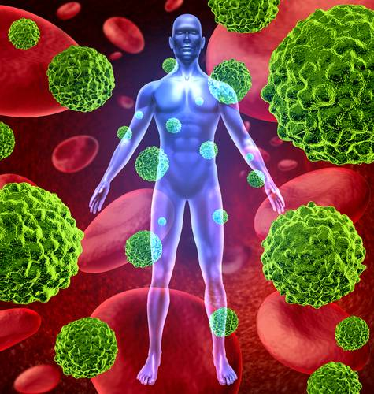
IMMUNITY

Slide 3
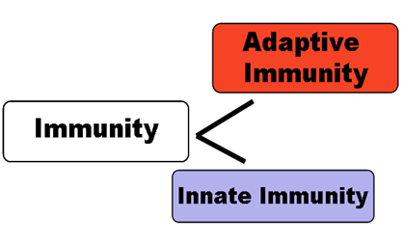
IMMUNITY & ITS TYPES
IMMUNITY - Its how your body recognizes and defends itself against bacteria, viruses, and substances that appear foreign and harmful.
IMMUNE SYSTEM- Its a network of tissues and organs containing cells that recognize foreign substances in the body and destroy them.

Slide 4
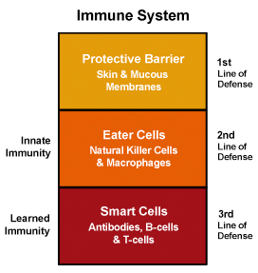
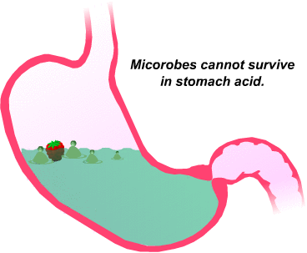
MECHANISM OF IMMUNITY

Slide 5
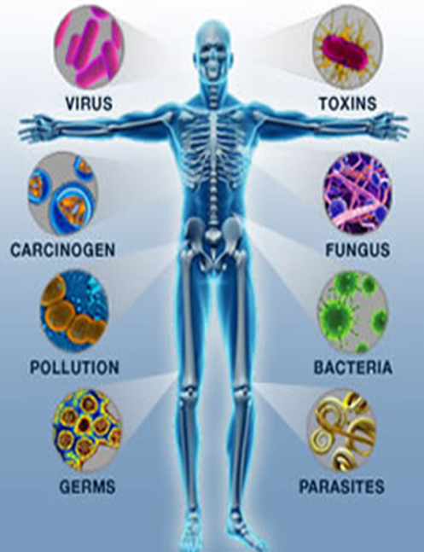
Signs of Weak Immunity:
Frequent allergies
Low energy levels
High Blood Sugar
Digestive Issues
Feeling Sluggish
Food Sensitivities
High Blood Pressure
Trouble Sleeping
Chronic Skin Conditions
Take longer to recover from injury

Slide 6

SPIRULINA

Slide 7
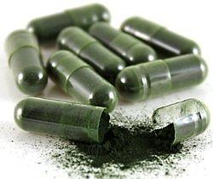
SPIRULINA & ITS NUTRITIONAL CONTENT
Spirulina is packed with many vital nutrients that can protect you from illness and disease:
  Beta Carotene - 10 times more than in carrots
  Protein - About 55 - 77% protein and 18 essential amino acids
  Gamma linolenic acid (GLA), one of the rarest essential fatty acids
  Vitamins - Vitamin B, Vitamin C & Vitamin E
  Minerals - Potassium, calcium, chromium, copper, iron and magnesium

Slide 8
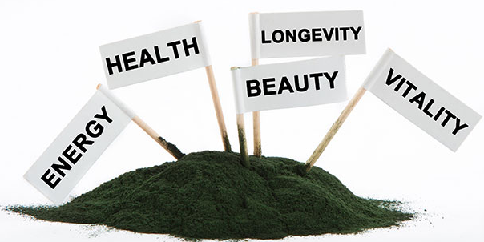
SPIRULINA
CAN BE BENEFICIAL IN-
General Weakness, fatigue, early aging
Skin Problems like Acne or dry Skin
Diabetes
Anemia
Memory Loss
Poor Vision
Hyper acidity
Ulcers

Slide 9
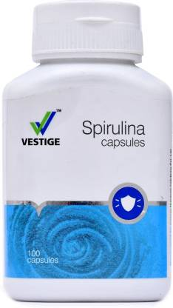
DOSAGE
One capsule twice a day after meals

Slide 10
NONI

Slide 11
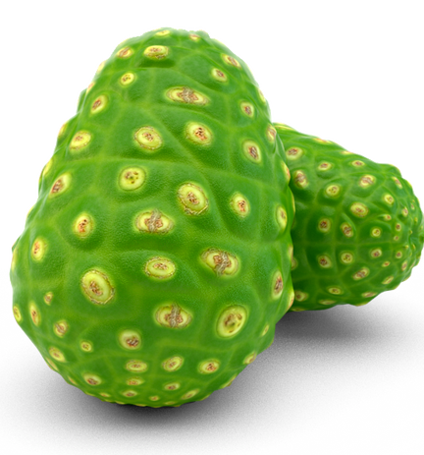
NONI
It contains proxeronine that helps the body to absorb nutrients. Noni works on body cells, increase the pore size and helps in the absorption process.
It contains “Damnacanthal” that proved to be beneficial in inhibiting the growth of pre-cancer cells.
Noni fruit is rich in biotin, folate, vitamin E and plant-based flavonoids, organic acids with antioxidant properties.

Slide 12
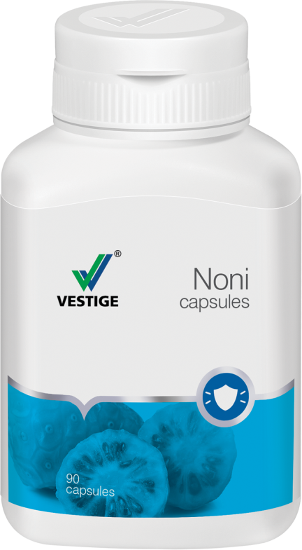
CASES WHERE NONI CAN BE HELPFUL
Increases energy levels, shields muscle cells from wear and tear and improves performance.
anti-inflammatory qualities, for increasing flexibility of connective tissues, banishing stiffness in bones, joints.
antioxidants, polyphenols in noni significantly lower bad LDL cholesterol.
Noni is packed with antioxidants which removes harmful free radicals from the system, to augment physical fitness, mental wellness and overall health.

Slide 13
DOSAGE
One capsule twice a day before meal.

Slide 14
ALOEVERA

Slide 15
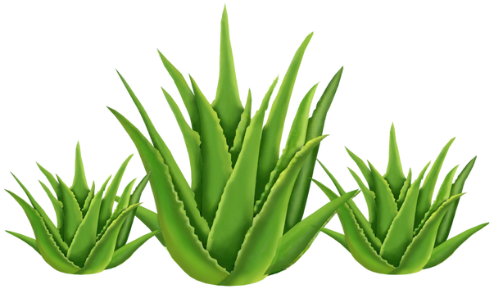
ALOEVERA & ITS NUTRITIONAL CONTENT
Minerals:
Calcium
Sodium
Iron
Potassium
Chromium
Magnesium
Manganese
Copper
Zinc
Vitamins:
Vitamins A
Vitamin B1,B2
Vitamin B6,B12
Vitamin C
Vitamin E
Folic Acid
Niacin
ALOEVERA= Healing + Soothing + Laxative + Rejuvenating properties

Slide 16
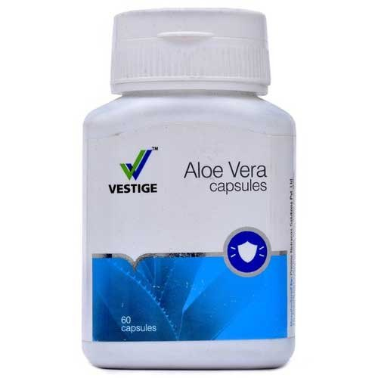
DOSAGE
One capsule twice a day empty stomach.

Slide 17
AMLA

Slide 18
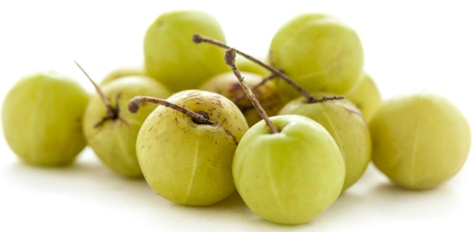
AMLA
Amla- The Fruit of Life
The strong belief in “prevention is better than cure” has led to Amla being incorporated in several supplementary health products

Slide 19

AMLA & ITS NUTRITIONAL CONTENT
CONTAINS -
Vitamin C - Potent antioxidant
Calcium - Mineral required for strong bones
Phosphorus - Mineral vital for growth, bones & teeth
Other Natural Antioxidants

Slide 20
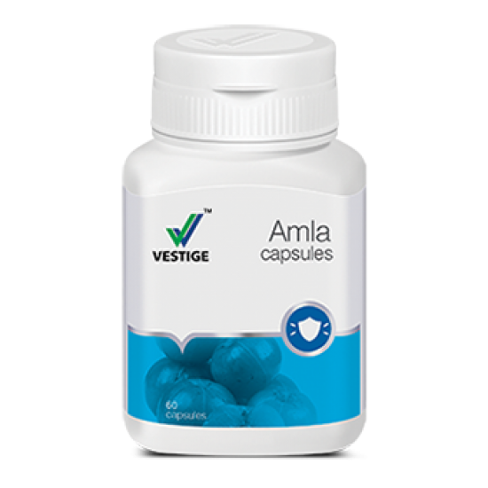
DOSAGE
One capsule twice daily empty stomach .

Slide 21
COLOSTRUM

Slide 22
COLOSTRUM
CONTAINS -
37 Specific Immune Factors
5 Vital Immunoglobulin
Protease inhibitors
Over 8 types of Growth Factors
Growth Hormones
Major & Minor Vitamins
Minerals

Slide 23
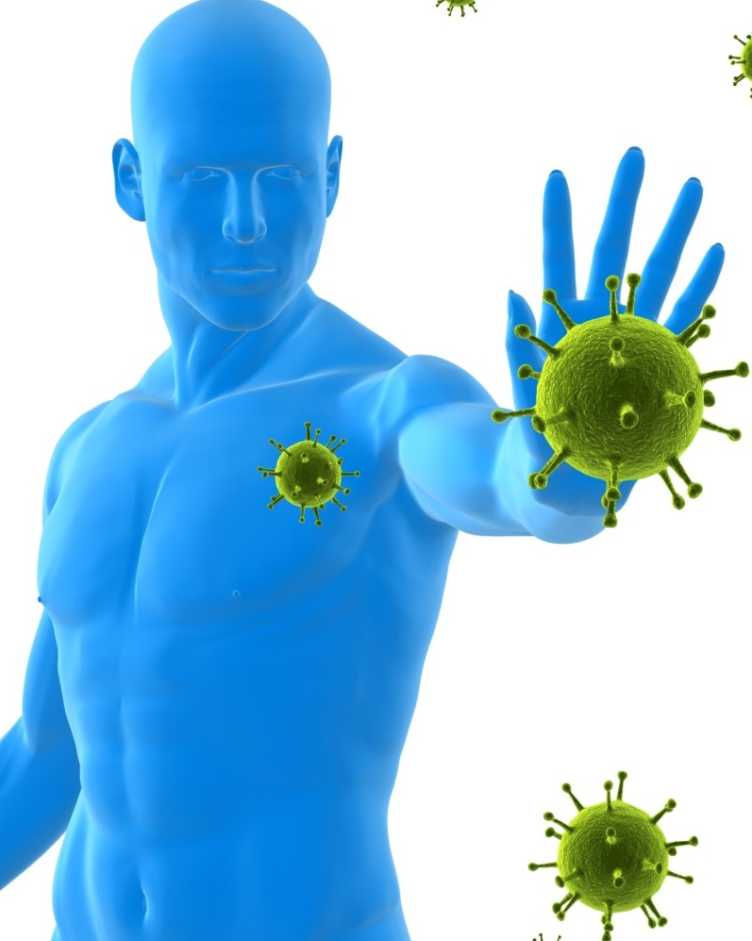
COLOSTRUM CAN BE HELPFUL IN
Helps to boosts the immune system of the body
Controls inflammation
Protects against allergic reactions
Helps to repair & rebuild cellular tissues
Helps to restores impaired health
Helps to improve nutrient uptake
Helps to increases bone mass
Restores skin elasticity
Energizes the body
Helps to increase memory
Normalizes the fat usage

Slide 24
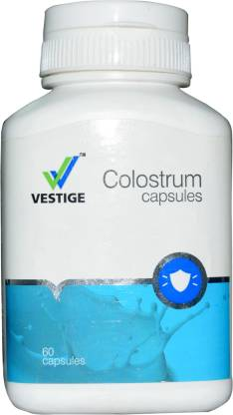
DOSAGE
One capsule twice daily after meals.

Slide 25
What we get when we buy immunity set
Complete protection against diseases .
Spirulina is known to be a multivitamin and multi mineral supplement which provides all the necessary nutrition to body.
Noni works on cells and helps to remove toxins from the cells and also helps in the absorption of the food we eat. Noni helps in the absorption of nutrients we get from spirulina.
Aloe vera brings strong digestive system and create soothing and calming effect in body.
Amla provides vitamin C which is the powerful anti oxidant and known to build immunity.
Colostrum is a poweful immunity booster.

Slide 26
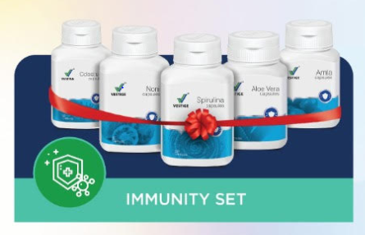
IMMUNITY SET
Immunity set provides you all the necessary products which helps to develop body immunity and keep you healthy and strong.
It is a powerful combination of different products which helps to create a strong body by providing all the necessary major micro nutrients known to develop immunity since ages.
A set with complete protection and benefits.

Slide 27
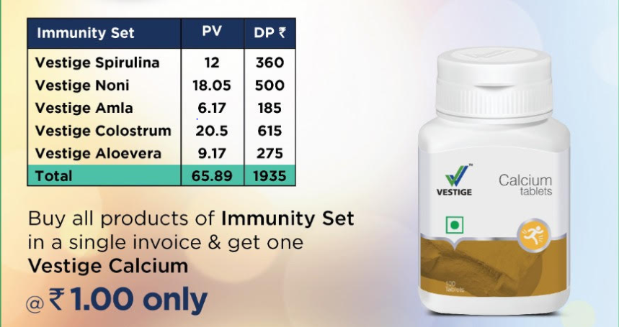
IMMUNITY KIT

Slide 28
THANK YOU

