Slide 1
VESTIGE EYE SUPPORT
Introducing

Slide 2
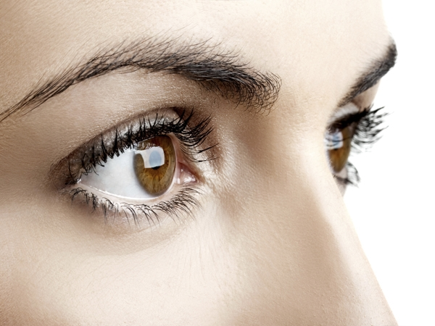
IMPORTANCE of Eye Health
Eyes are an important part of our health
Eyes play a major role in mobility, function and enjoyment of life
When it comes to common vision problems, some people don’t realize that they have eye problems
In addition, many common eye diseases such as glaucoma, diabetic eye disease and age-related macular degeneration often have no warning signs
Just as it is important to keep our body healthy, we also need to keep our eyes healthy

Slide 3
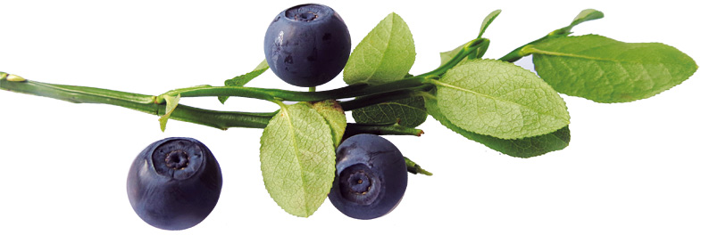
INTRODUCTION to Vestige Eye Support
Vestige Eye Support contains Marigold and Bilberry extracts as major ingredients, which are beneficial for eye health
This product has Lutein and Zeaxanthin, which helps in improving the eyesight, night vision and prevent eye irritation

Slide 4
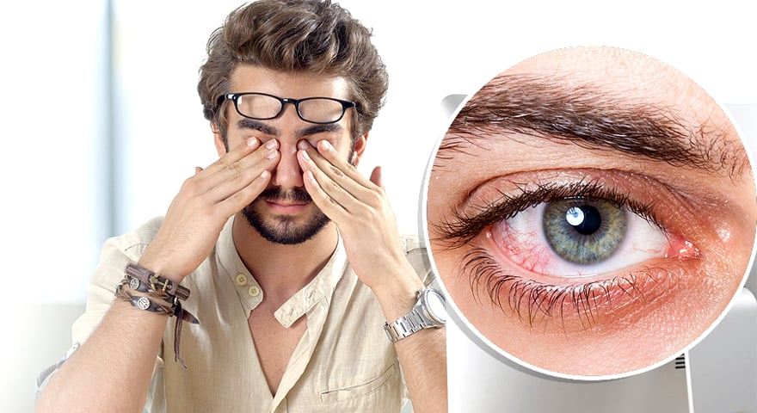
COMMON Eye Problems
Eyestrain
Red Eyes
Blurred Vision
Eye Irritation
Dry Eyes
Excessive Tearing
Conjunctivitis
Corneal Diseases
Eye Allergies
Age-related macular degeneration (AMD) ranks 3rd among the global causes of visual impairment (by WHO)

Slide 5
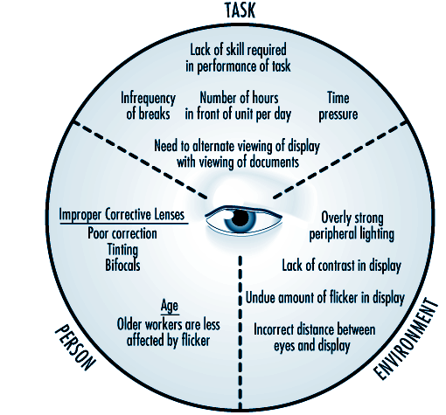
FACTORS affecting Eye Health
ACTIVITIES RELATED FACTORS:
Excess hours spent in front of TV, laptops, phones
Infrequency of breaks
Time/work pressure
INDIVIDUAL RELATED FACTORS:
Improper corrective lenses
Age
Medical issues
ENVIRONMENT RELATED FACTORS:
Improper lighting
Incorrect distance between eyes & display
Lack of contrast in display

Slide 6
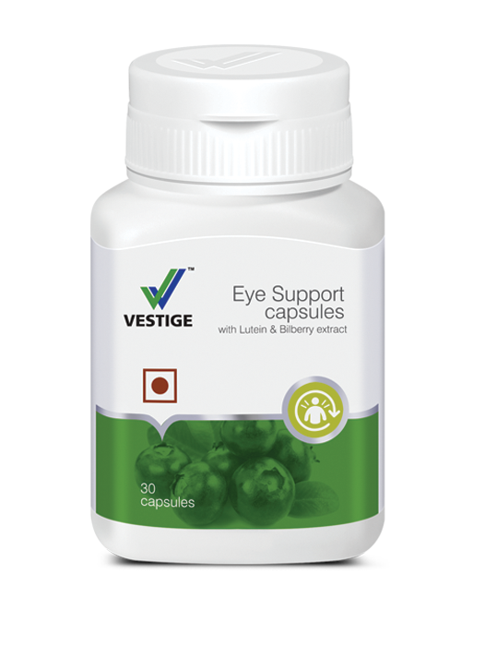
COMPOSITION

Slide 7
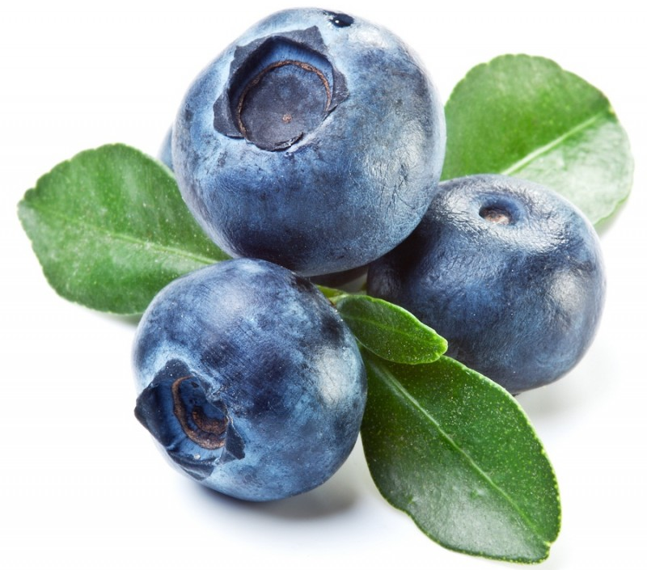
COMPOSITION of Vestige Eye Support
PICTURE | SCIENTIFIC NAME | COMMON NAME | FUNCTION
 | Tagetes Erecta Flower Extract | Marigold Flower | It helps in lowering Inflammation and free radical damage. Also helps in reducing eye Inflammation and Conjunctivitis
 | Vaccinum Myrtillus Fruit Extract | Bilberry Fruit | It has antioxidants and also helps in improving eyesight. It helps in preventing against eye conditions like age-related macular degeneration

Slide 8
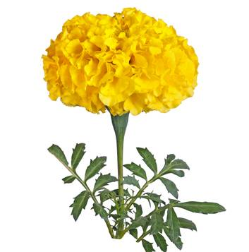
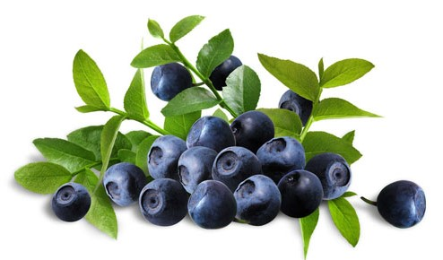
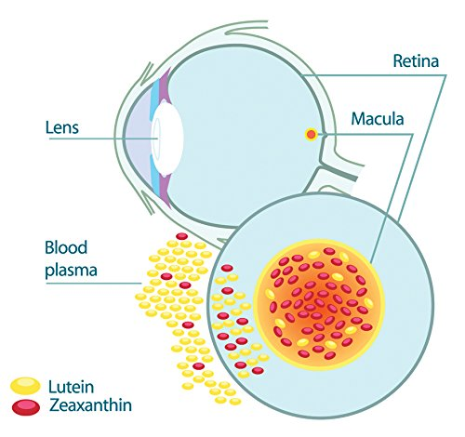
Marigold Flower & Bilberry Fruit
Marigold contains Lutein & Zeaxanthin which are antioxidants that are located in the eye but body does not naturally produce them so required from the external sources
They neutralizes free radicals associated with oxidative stress & retinal damage
They help protect eyes from harmful high-energy light waves like UV rays in sunlight
Studies suggest that a high level of Lutein & Zeaxanthin in eye tissue is linked with better vision, especially in dim light or where glare is a problem
Bilberry is also rich antioxidants that may help hold off age-related eye diseases

Slide 9
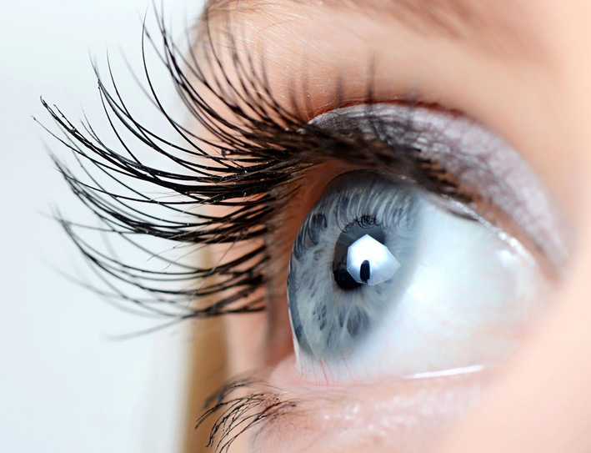
BENEFITS of Vestige Eye support
Helps in the maintenance of normal vision
Helps in improving eye sight and night vision
Helps soothe eye irritation
It also helps in eye disorders like macular degeneration, eye inflammation and other retina related complications
Due to its antioxidants property helps in preventing free radical damage
It helps in reducing eye Inflammation and Conjunctivitis

Slide 10
DOSAGE of Vestige Eye Support
Two capsules daily with meals

Slide 11
Vestige Eye Support
30 Capsules
MRP Rs. 625.00
DP Rs. 575.00
BV 345
PV 19.17

