Slide 1

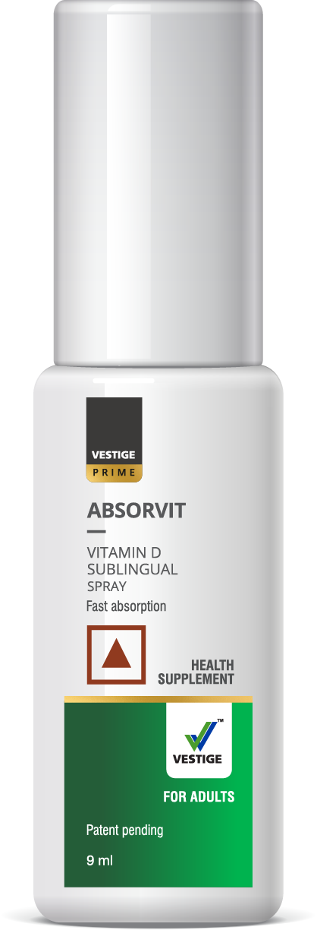
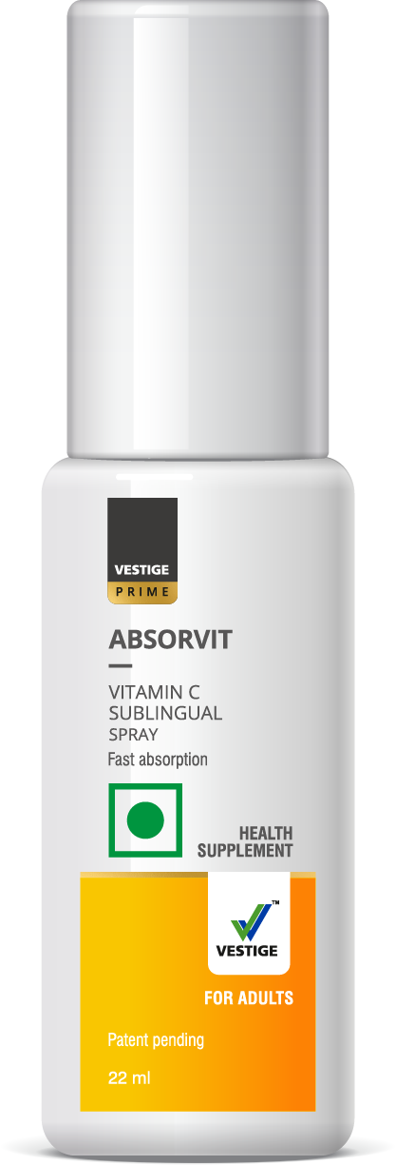
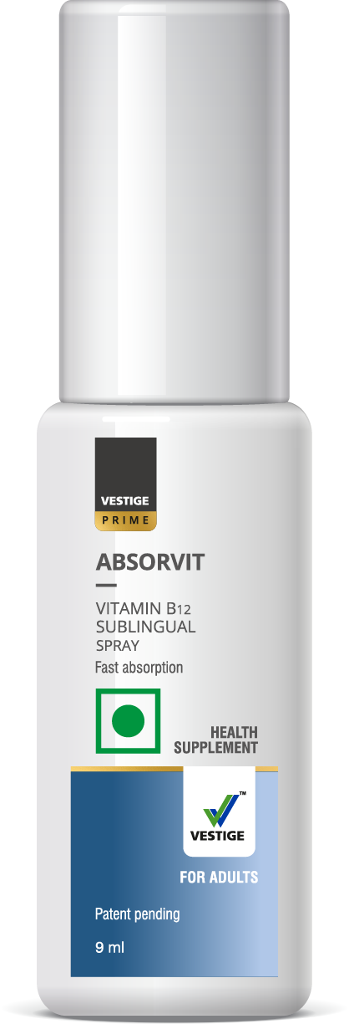
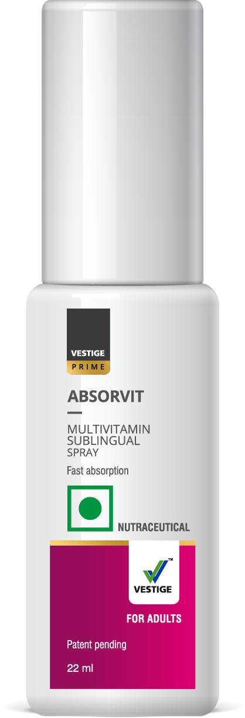

INTRODUCING,
VESTIGE PRIME ABSORVIT
SUBLINGUAL SPRAY
YOUR UPGRADED
DOSE OF VITAMINS

Slide 2

Do you know?
75% of Indians are ‘vitamin deficient’…
Ref:https://health.economictimes.indiatimes.com/news/industry/75-of-indians-suffer-vitamin-deficiency-study/49436690

Slide 3

Vitamin deficiency may lead to serious health issues!

Slide 4
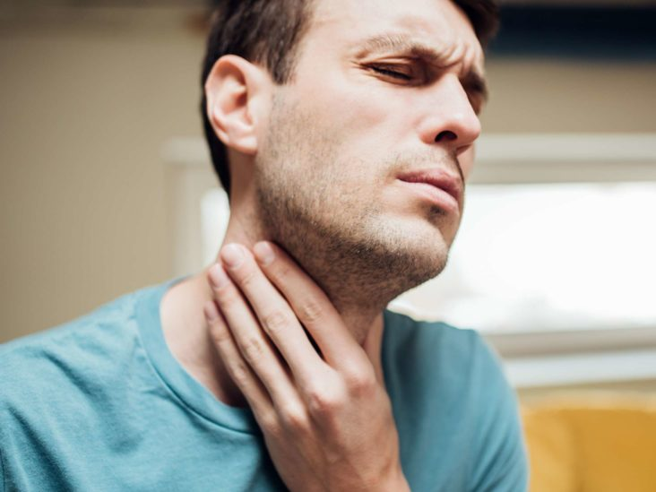
TWO MAJOR REASONS THAT LEADS TO VITAMIN DEFICIENCY ARE
1
2
Non-Compliance (Difficulty in swallowing)
Poor Oral absorption

Slide 5
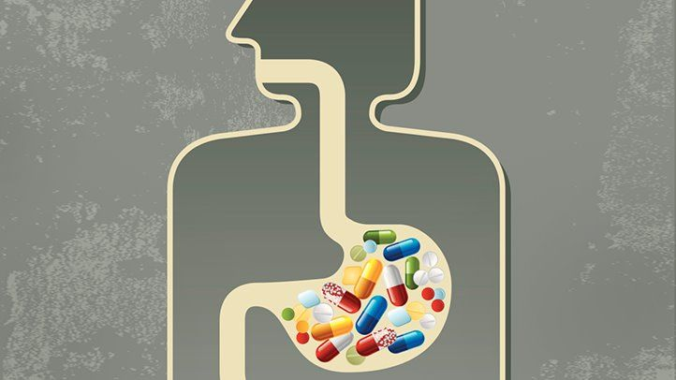
WHY POOR ORAL ABSORPTION IS SERIOUS?
Very less QUANTITY of
vital nutrients
reaches to systemic circulation through the conventional dosage form *
*Ref: https://www.nutrivitality.com/body-absorb-vitamins/.

Slide 6
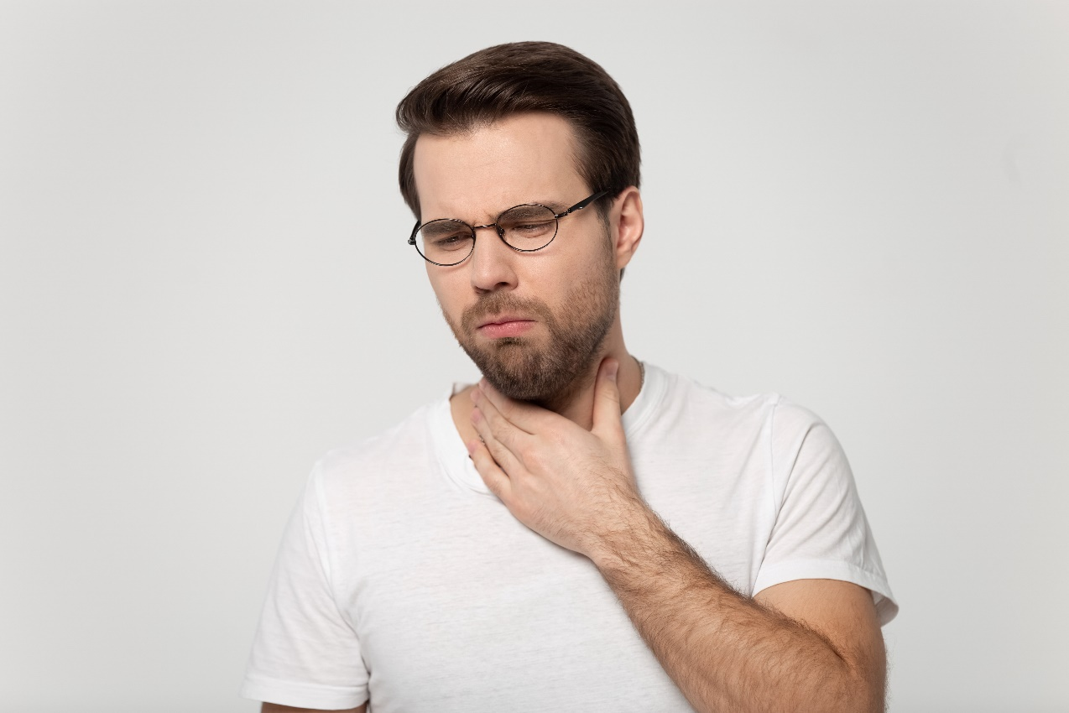
MAJOR REASONS FOR NON–COMPLIANCE OF DRUG
Difficulty in swallowing
Missed Dose
Age factor : Kids , Geriatric patients
Cultural Issues
Too many medications
Busy Lifestyle : Frequent Travelling
POOR availability of drinking water
Poor taste & odour of medication

Slide 7
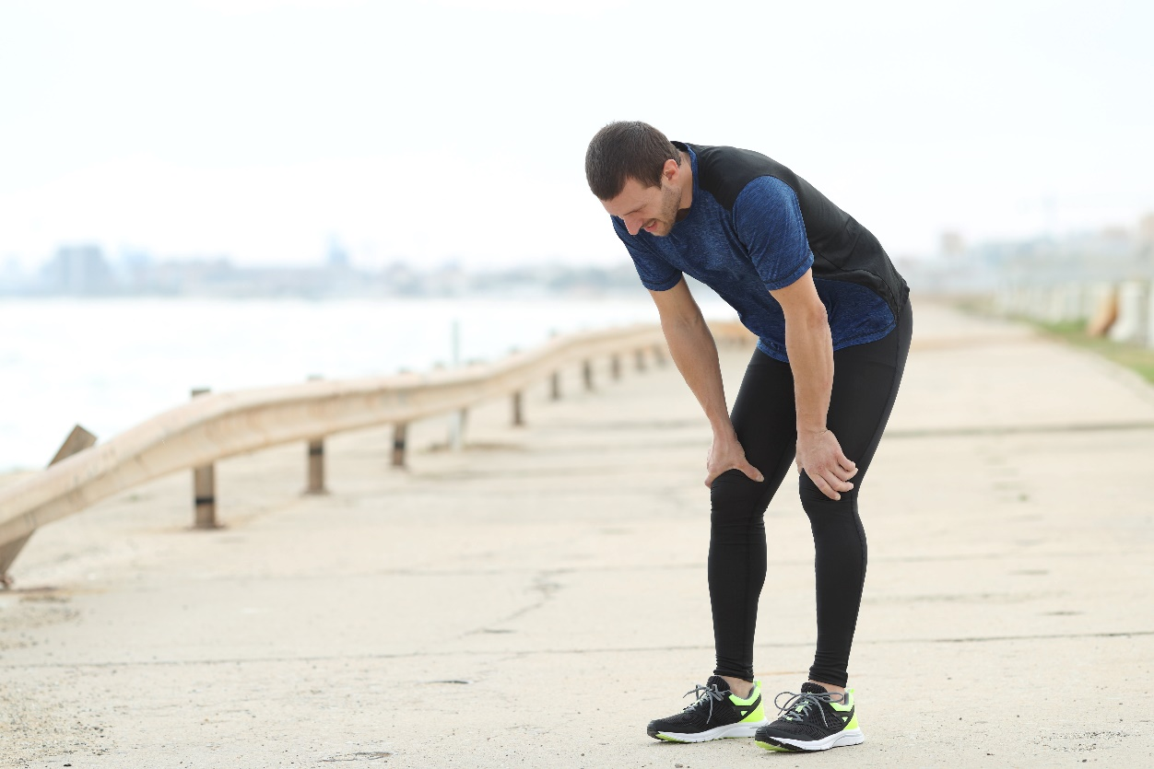
DEFICIENCY OF VITAMINS LEADS TO:
Frequent illness,
Low energy,
Malnutrition
Fatigue and
Host of other diseases that can put you down

Slide 8

How to deal with these conventional issues ?

Slide 9
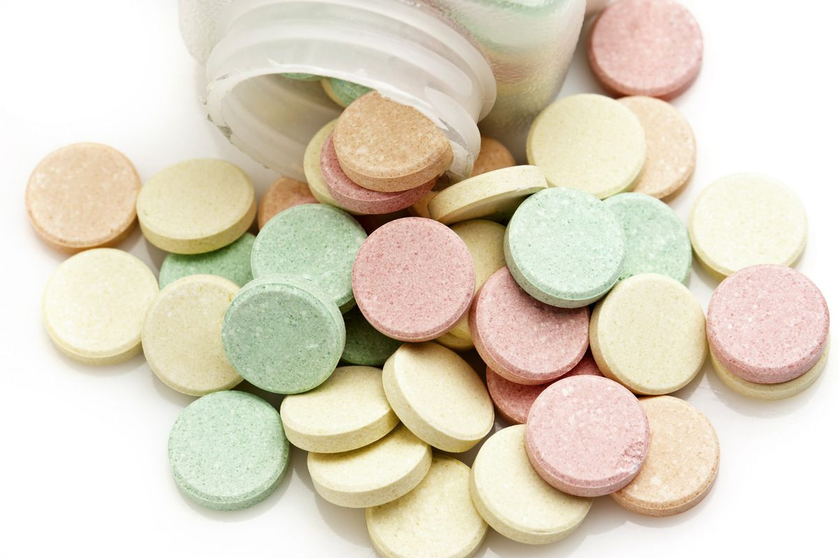
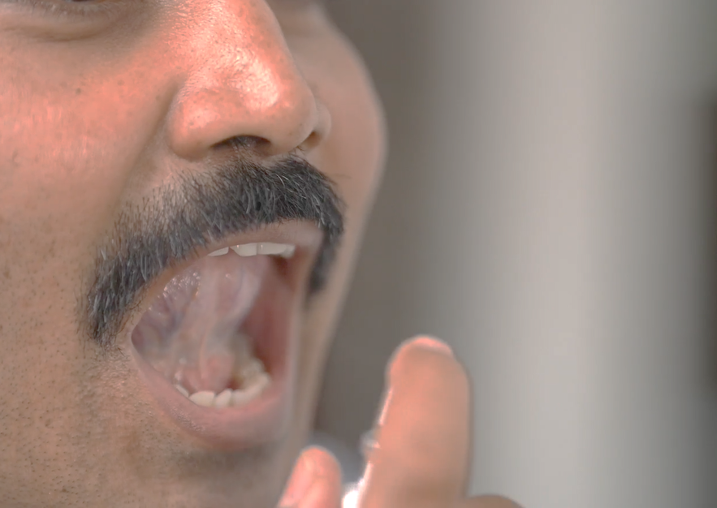
Technology has helped to improve the effectiveness of Vitamins
Conventional Dosage Form
Upgraded Dosage Form (Sublingual sprays)

Slide 10
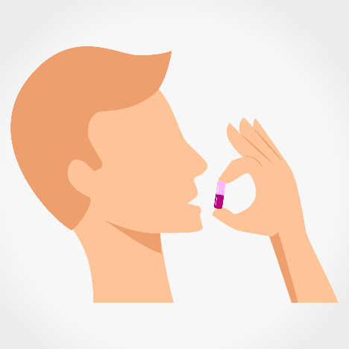
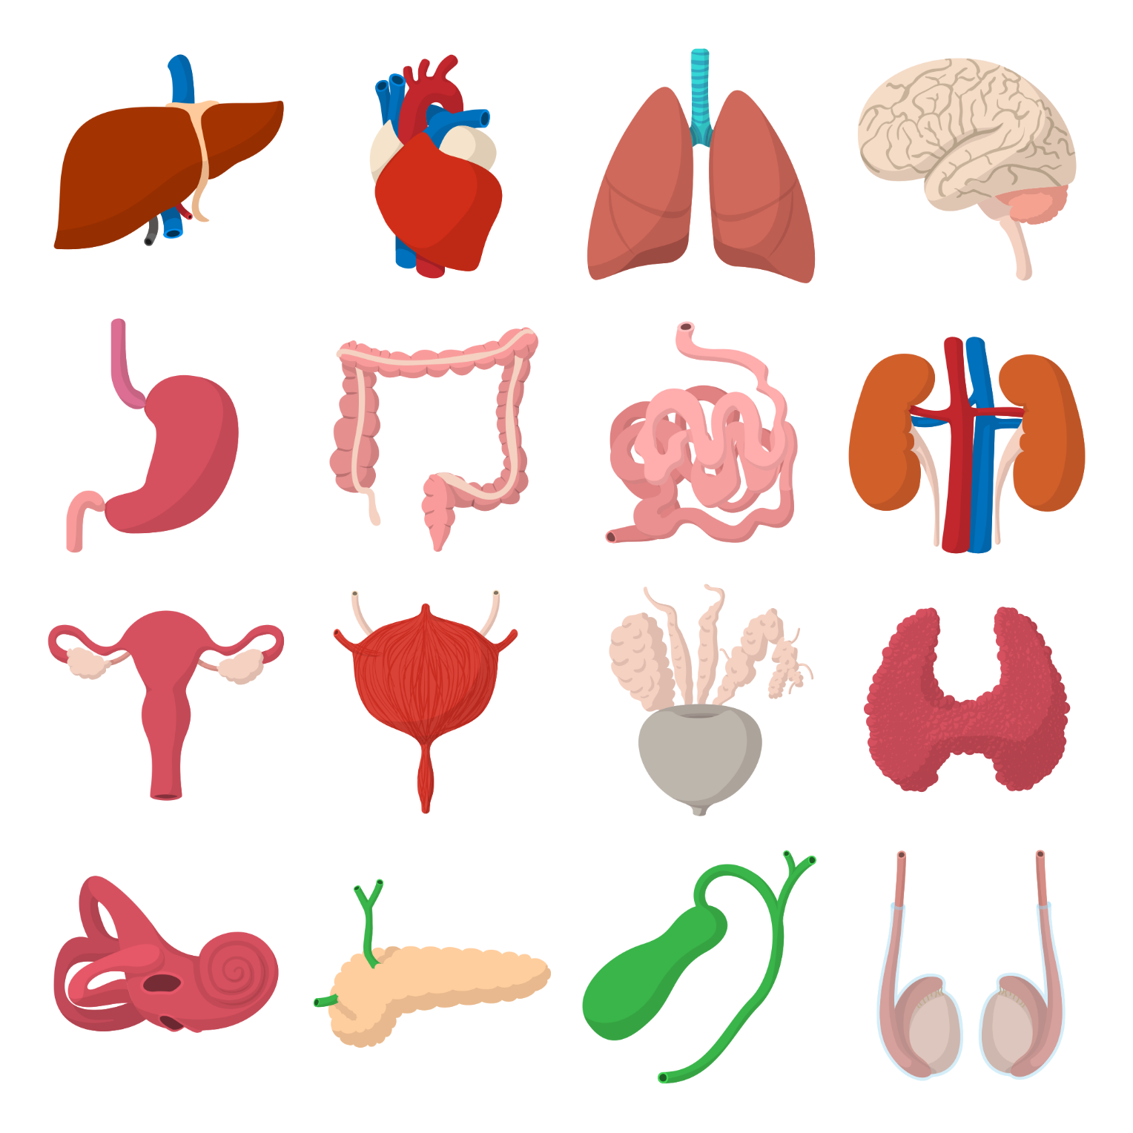
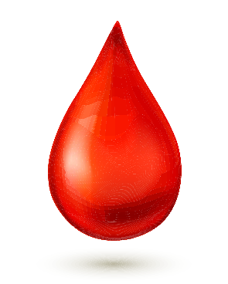

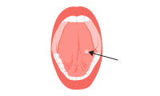
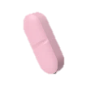
SUBLISPRAYTM TECHNOLOGY
Conventional Dosage Form
Stomach
Liver
Blood Stream
Modern Dosage Form
(Sublispray technology)
Blood Stream

Slide 11
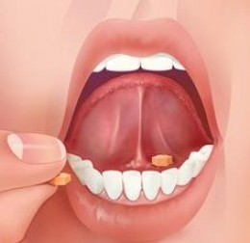
MODERN Dosage Form(Sublingual Route)
Sublingual administration of drug refers to the placement of drug under the tongue
The sublingual route bypasses the first-pass metabolism and hence facilitates rapid absorption of the drug into the systemic circulation (Blood Stream) directly

Slide 12
How sublingual spray bypasses first pass metabolism?
A- Absorption
D- Distribution
M- Metabolism
E- Excretion
SUBLINGUAL ROUTE
Directly reach to
Blood stream
Blood stream

Slide 13
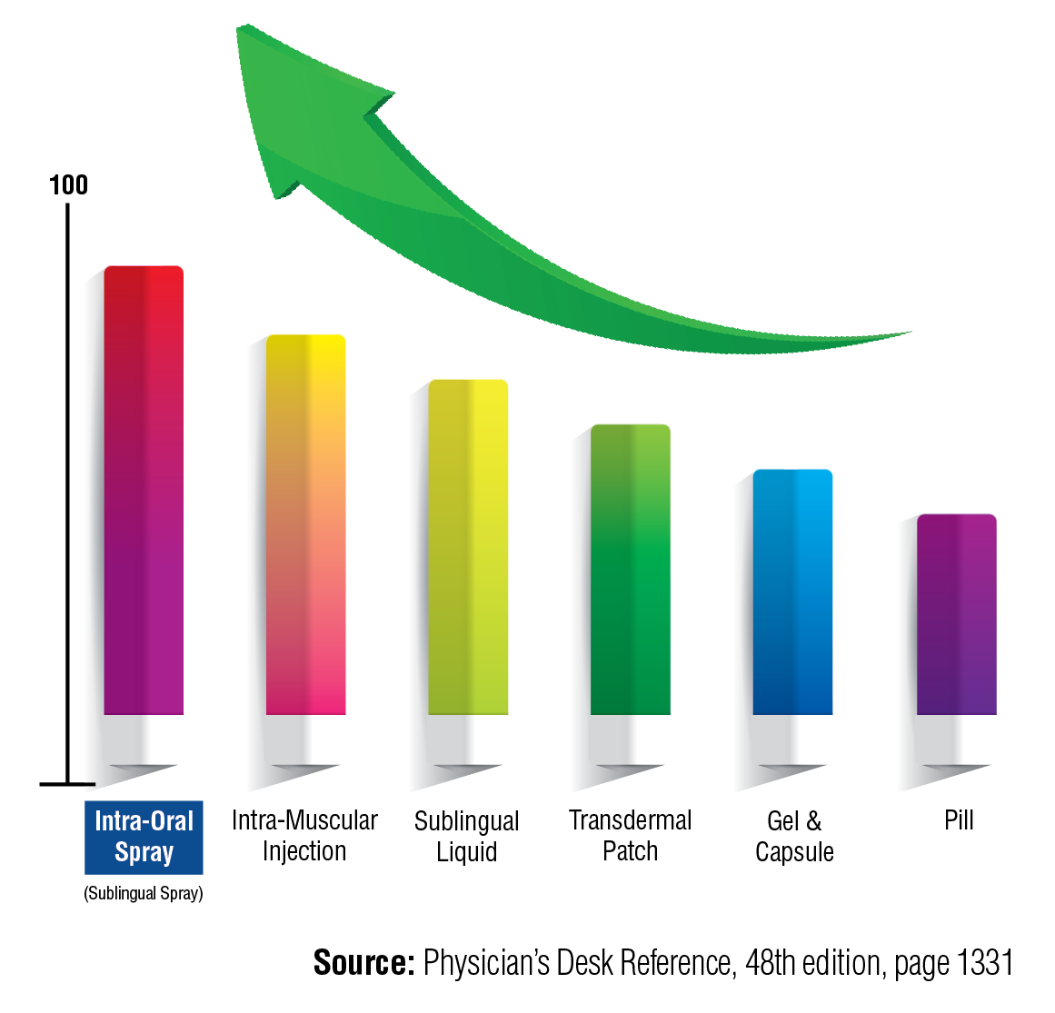
Up to 90% absorption of VITAL nutrients
with sublingual spray compared to
other dosage forms

Slide 14
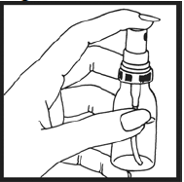
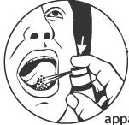
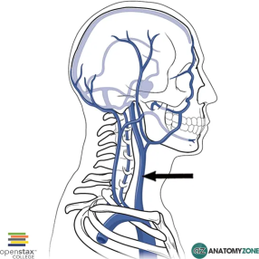
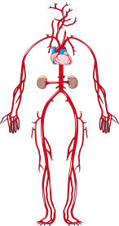

STAGES OF Sublingual Pathway
Sublingual Spray
Salivary Gland
Jugular Veins
(veins in your neck)
Arterial circulation
Absorbed in the body
UPTO 90% of vital nutrients are absorbed in the body

Slide 15
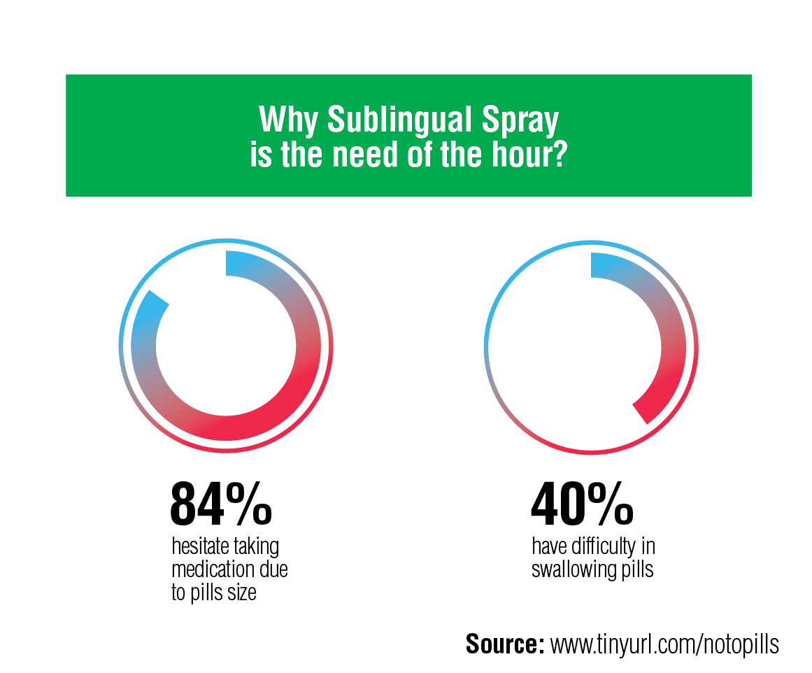
Why Sublingual Spray is the need of the hour?

Slide 16
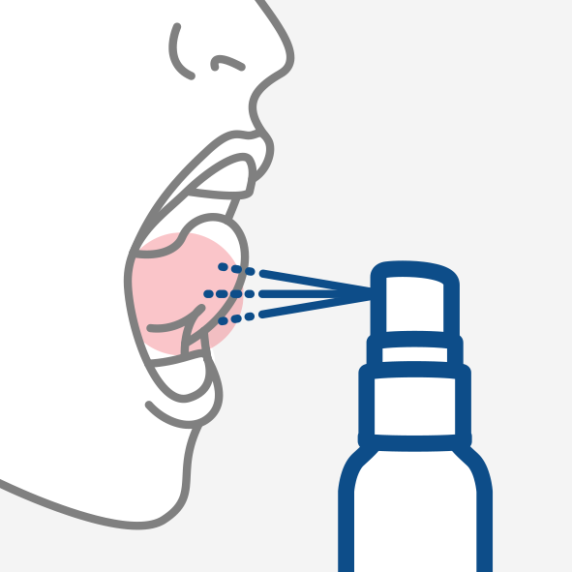
SUBLINGUAL SPRAY BENEFITS
Faster drug absorption: Quicker onset of action
Upto 90% absorption of vital nutrients
Avoids first-pass metabolism
Convenient to use
Easy to carry
This route can be also used, who have difficulty in swallowing tablets
No need of water to take the recommended dose
Great Taste

Slide 17
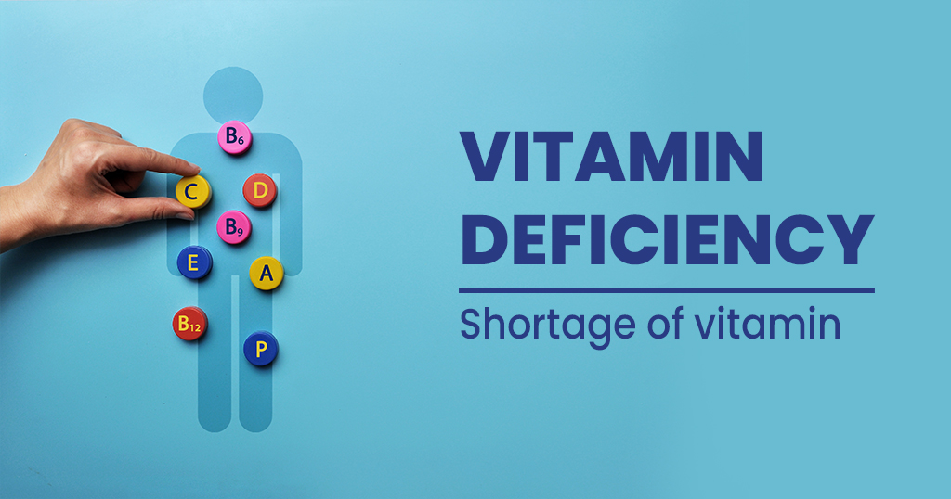
Let’s understand more about Vitamin deficiency…

Slide 18

Vitamin D Insufficiency in India : A Growing Threat
Nearly 76 % of Indians suffer from Vitamin D insufficiency
Ref: The Print, SUBHASREE RAY 10 December, 2021 11:37 am IST

Slide 19
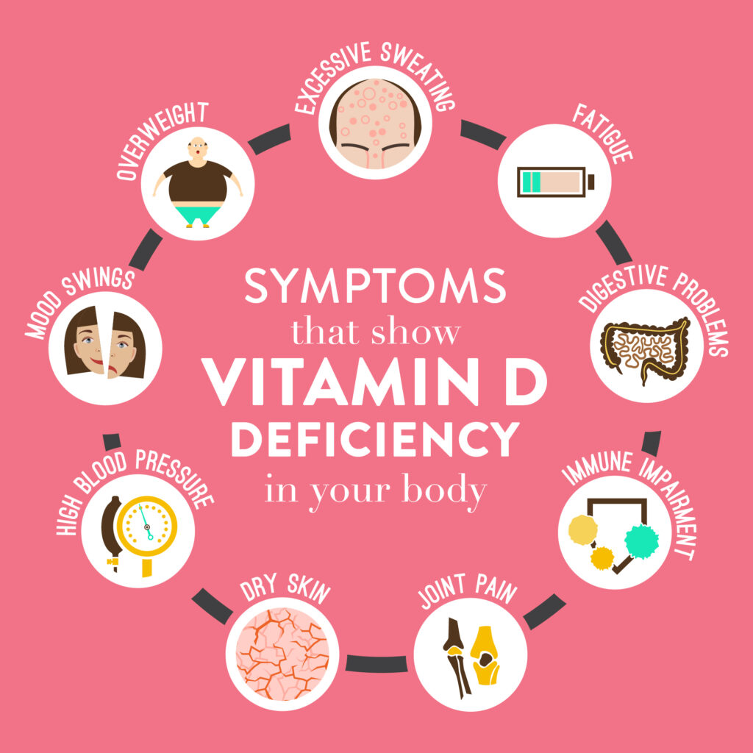

Slide 20

Pandemic has made Vitamin C important!
As per a study 73% Indians are Vitamin C deficient.
Vitamin C helps you stay immune from vital infections.
Ref: The pubmed ncbi,2011;6(12):e28588. doi:10.1371/journal.pone.0028588. Epub 2011 Dec 6

Slide 21
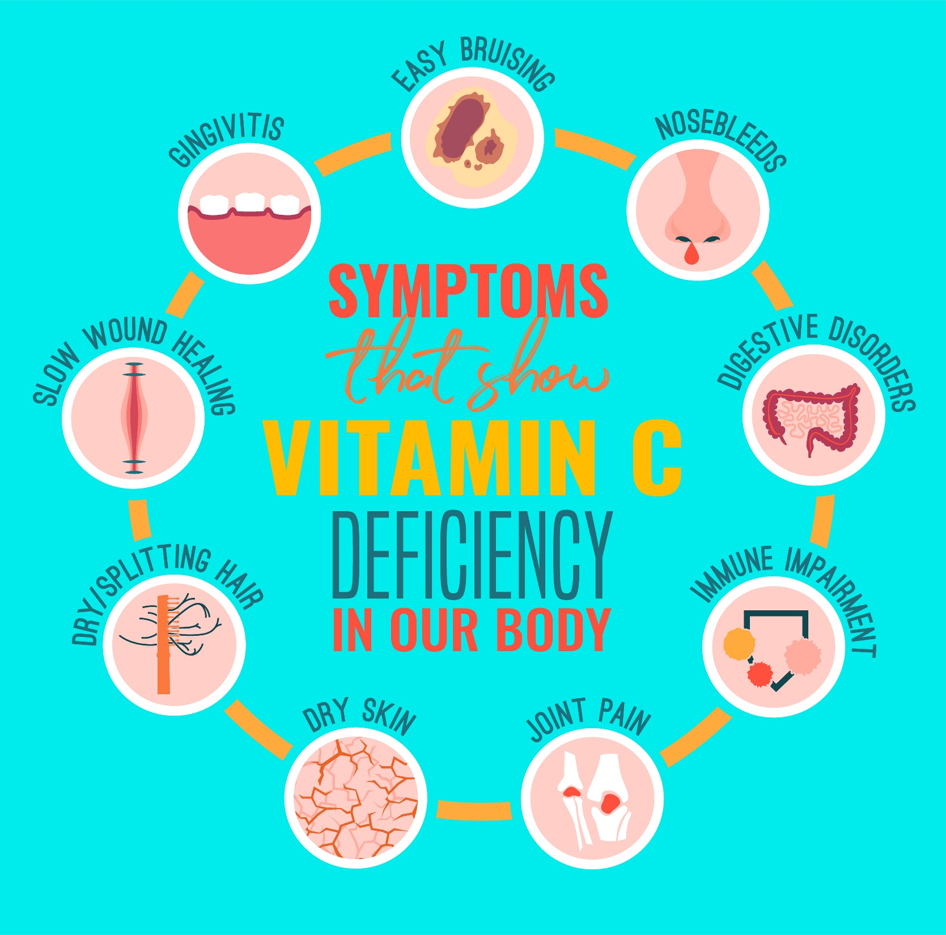

Slide 22

Vitamin B12 Deficiency is Endemic in Indian Population
At-least 47% Indians are Vitamin B12 deficient
Prevalence of vitamin B12 deficiency is 47% in north Indian population. People with diabetes have higher vitamin B12 levels than general population though still have high prevalence of deficiency. This data shows that Vitamin B12 deficiency is widespread in Indian population
Indian Journal of Endocrinology and Metabolism: Mar–Apr 2019 - Volume 23 - Issue 2 - p 211-214doi: 10.4103/ijem.IJEM_122_19

Slide 23
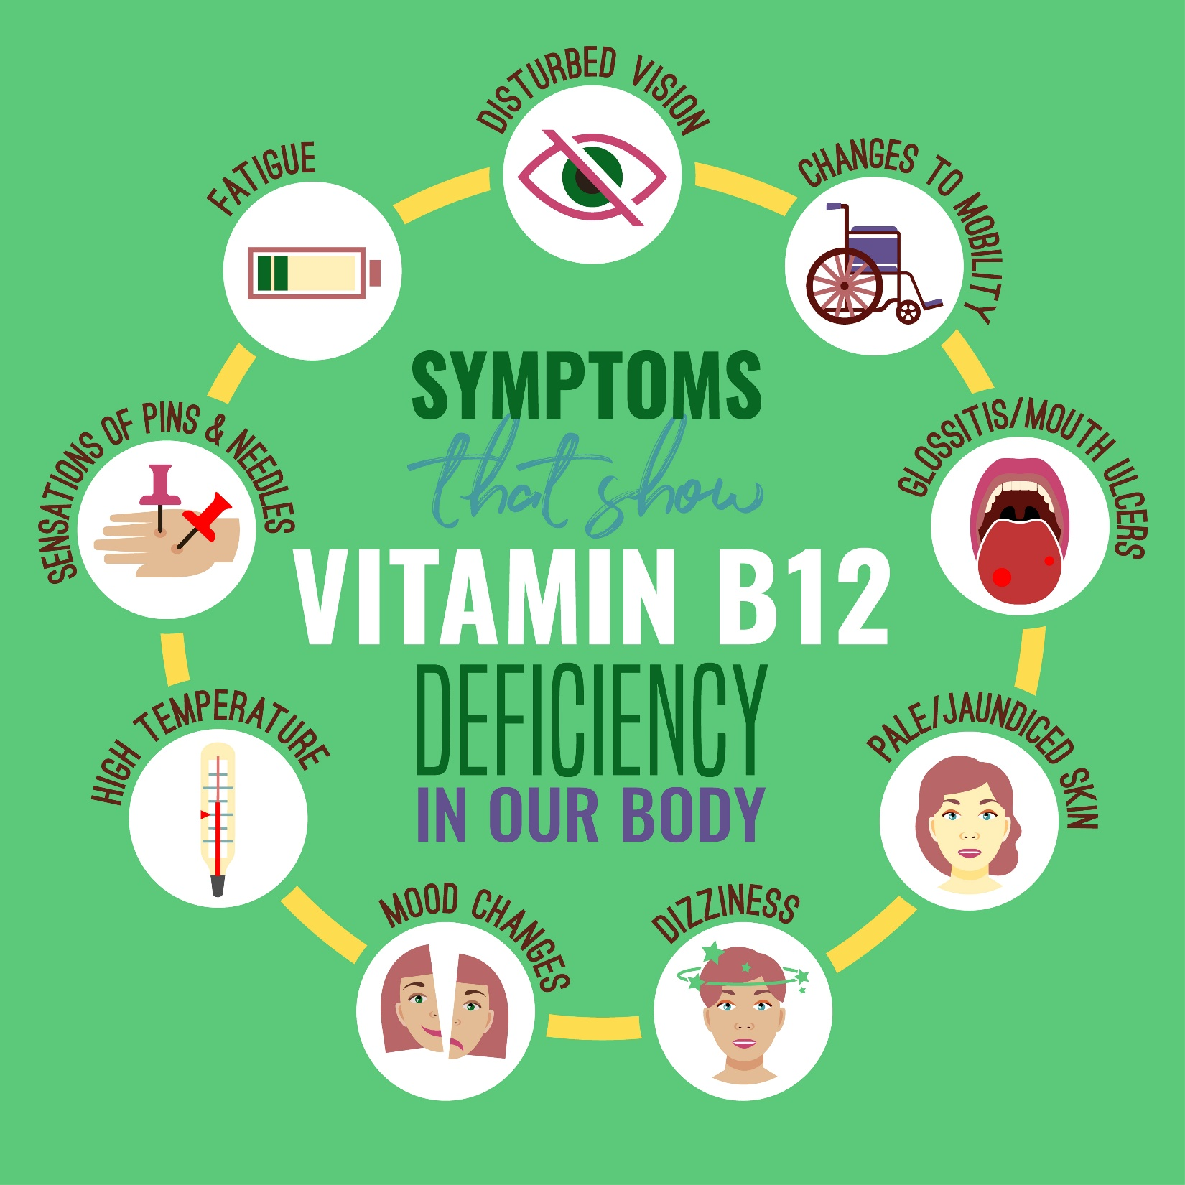

Slide 24

Need of a
‘revolutionary solution’
to deal with the conventional issues…

Slide 25
Wait Is Over !!
The Revolution Is Here…
Vestige Prime ABSORVIT Sublingual Spray

Slide 26
FASTER ABSORPTION OF VITAL NUTRIENTS
An innovative dosage form that
upgrades the conventional way of taking vitamins
BETTER COMPLIANCE
UPTO 90% ABSORPTION OF VITAL NUTRIENTS

Slide 27
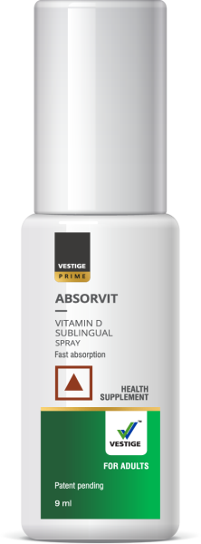
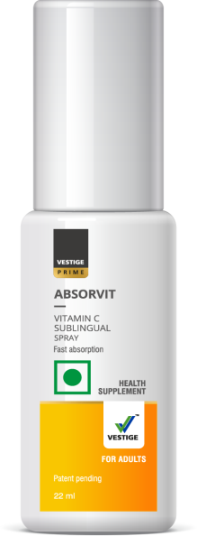
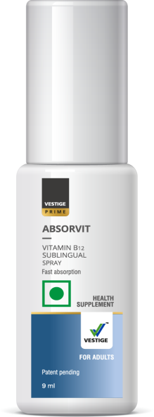
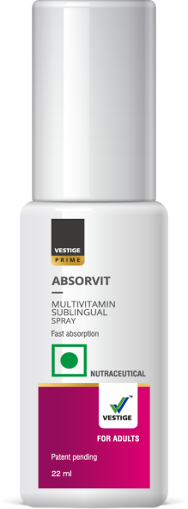
Why Vestige Prime Absorvit?
Powered with sublisprayTM technology (patent pending)
An innovative, faster and efficient sublingual spray
Improves the conventional dosage form and provides quicker absorption for improved outcomes.

Slide 28
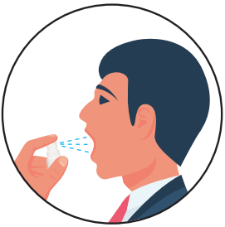


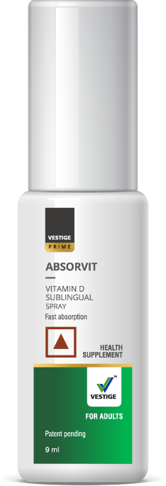

How to Use Vestige Prime Absorvit?
Shake well before use
Spray directly under the tongue
Just 3 sprays a day
Just 1 spray a day
Just 1 spray a day
Just 3 sprays a day

Slide 29
VESTIGE PRIME Absorvit Vitamin C:
Acts as an antioxidant by preventing cell damage from free radicals
Helps to maintain immunity and protects the body from infections like cold & cough
Helps in maintaining healthy skin, blood vessels, bones and cartilage
As per ICMR* it's recommended to have 80 mg of Vitamin C daily for an adult
Just 3 sprays a day
* ICMR- Indian Council of Medical Research

Slide 30
VESTIGE PRIME Absorvit Vitamin B12:
Improves the body's ability to convert food into cellular energy thus maintaining healthy energy levels
Supports nerve health
Supports red blood cells formation
As per ICMR* it's recommended to have
2.2 mcg of Vitamin B12 daily for an adult
Just 1 spray a day
* ICMR- Indian Council of Medical Research

Slide 31
VESTIGE PRIME Absorvit Vitamin D:
Supports immune function
Helps in the absorption and regulation of calcium and phosphorus in the body thus maintaining good bone health
Has anti-inflammatory properties
As per ICMR* it's recommended to have 600 IU of Vitamin D daily for an adult
Just 1 spray a day
* ICMR- Indian Council of Medical Research

Slide 32
VESTIGE PRIME Absorvit Multivitamin:
Helps in fulfilling the nutrition gap between the diet & the body's requirement
Improves overall health
Helps in overall growth and daily maintenance of the body
Helps in maintaining higher energy levels
Just 3 sprays a day

Slide 33
VESTIGE PRIME Absorvit sublingual sprays
Solves the major issues of
Poor oral absorption
Non-Compliance

Slide 34
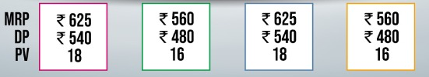

Slide 35
Why Swallow when you can
Subli-Spray?

Slide 36
Visit our nearest Branch/DLCP or MINI DLCP or you may shop online at www.shopmyvestige.com or on our
mobile shopping app

Slide 37
Thank You

