Slide 2
Eat Healthy, Live Healthy
Our food choices each day affect our health — how we feel today, tomorrow, and in the future
Good nutrition is an important part of leading a healthy lifestyle
Healthy eating habits can help prevent certain health conditions--such as obesity, high blood pressure and high cholesterol leading to heart disease
When you practice healthy eating habits, you boost your chances of an active and energetic life

Slide 3
Secrets to Healthy Cooking
When heating oil, bring it up to the appropriate temperature slowly
Do not fry in reheated fat or oil
During frying, continually skim off any food debris floating on the oil surface
When not in use, keep oil covered. This prevents oxidization that breaks down the oil quality
Cook the food just before serving, so no reheating/refrying is required, as it further destroys the nutrients
Always remember to use cooking oil in moderation

Slide 4
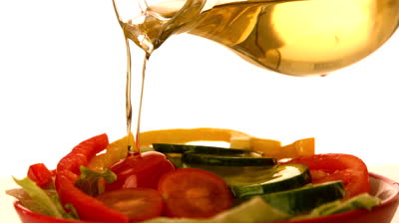
Choosing Healthy Fats
Fats are an essential part of daily dietary needs, their uses and benefits are innumerable
A good source for including fats in your diets is through cooking oil
Choosing the right cooking oil is of vital importance as this choice directly affects your health
The mix of fats that you eat, rather than the total amount in your diet, is what matters most when it comes to your cholesterol and health

Slide 5
Good Fats vs. Bad Fats
Fats are classified as:
Good fats
Bad fats
Monounsaturated fats (MUFA)
Polyunsaturated fats (PUFA)
Saturated fats
Trans fats
Monounsaturated fats (MUFA) and polyunsaturated fats (PUFA) are known as the “good fats” because they are good for your heart, your cholesterol, and your overall health.
Trans fats (bad fats)
Saturated fats (bad fats)

Slide 6
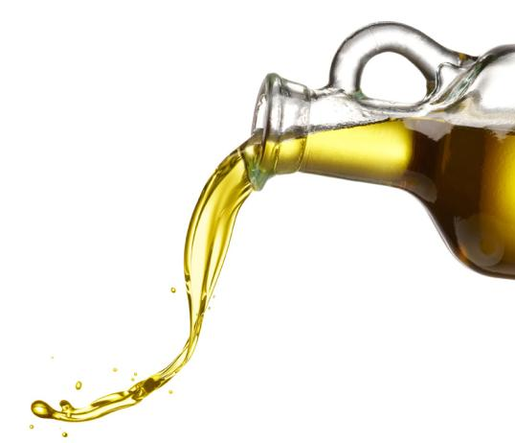
Recommended intake of oil
According to National Institute of Nutrition, RDA of visible fats (g/day)-
Adults
Men – 25-40 g/day
Women- 20-30 g/day
Adolescent- 35-50g/day
(1g equals 1 ml approx)

Slide 7
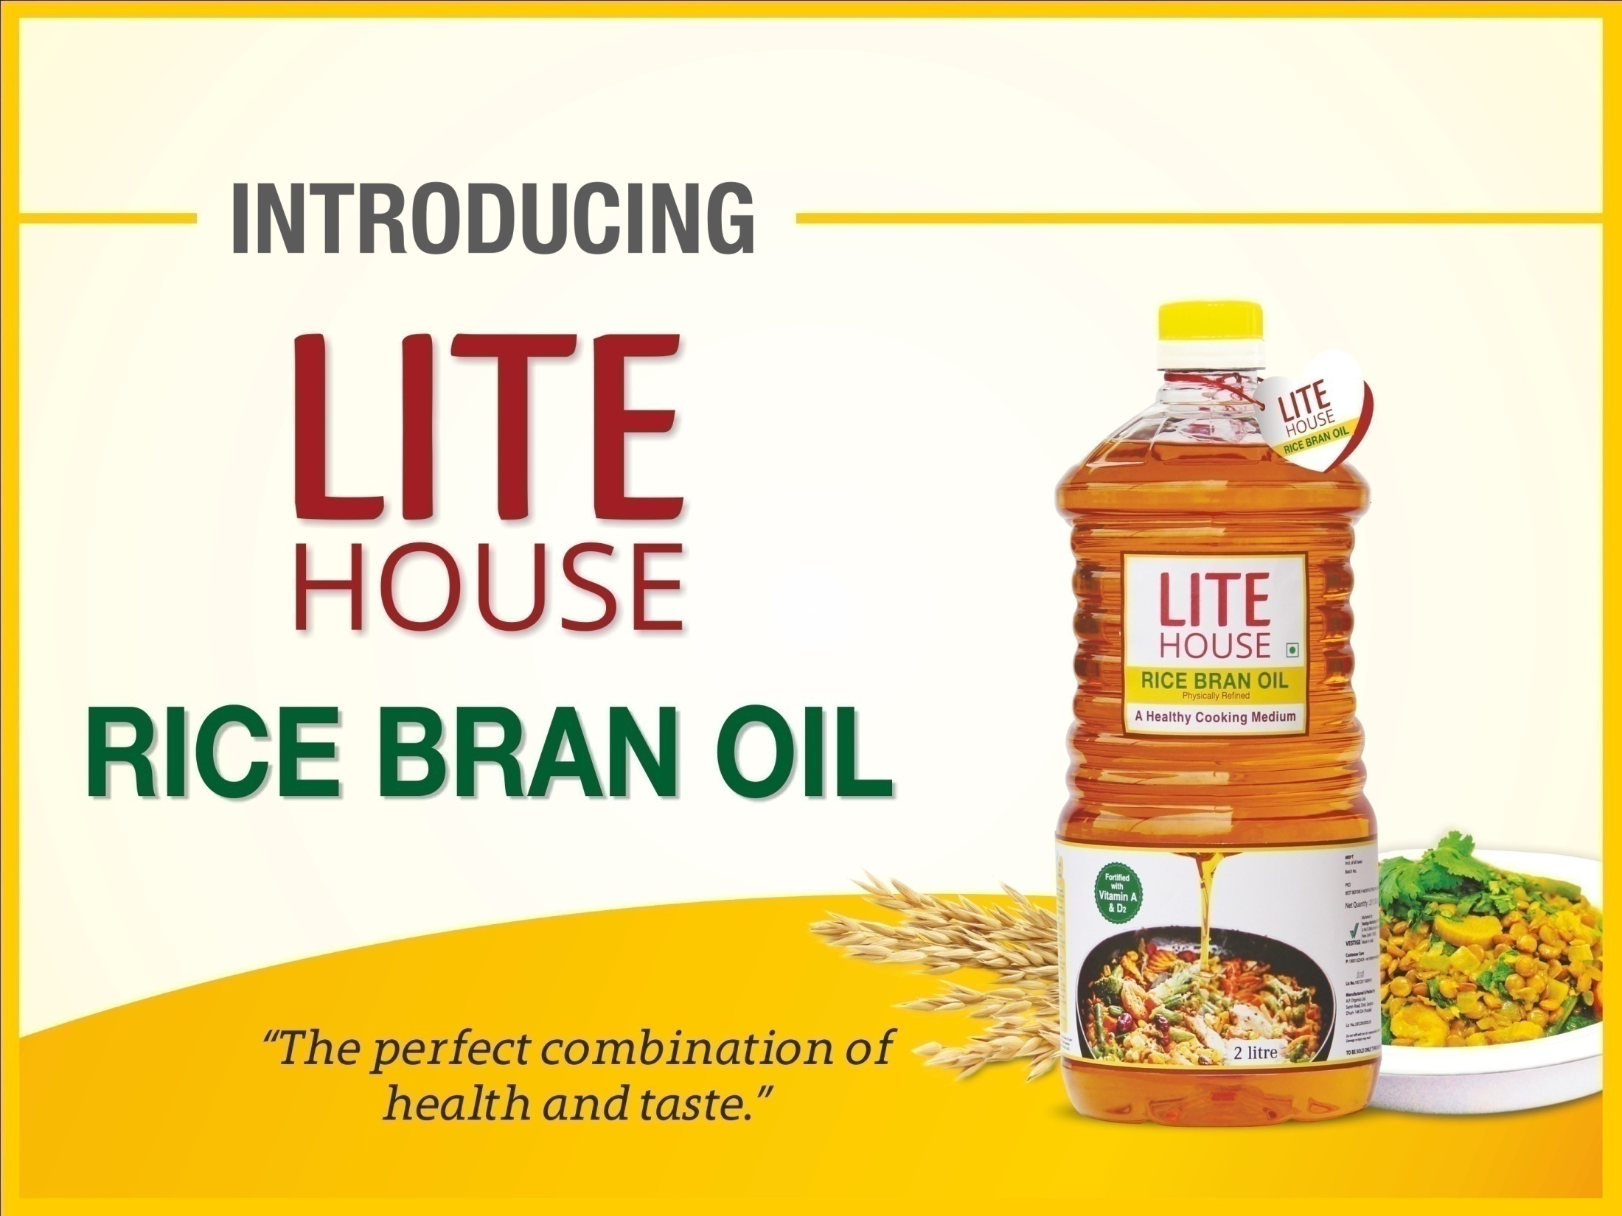

Slide 8
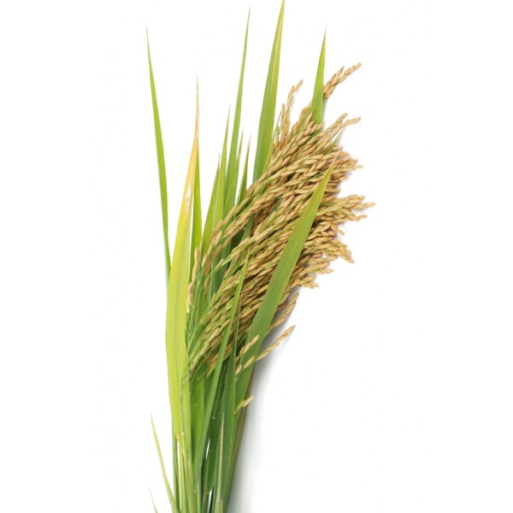
LITE HOUSE Rice Bran Oil
Source- This nutritious edible oil is produced from the only layer of brown rice.
Process of Refining- It is physically refined through a patented process which helps preserve the nutrients and the heart healthy compound- Oryzanol, which would otherwise be lost due to the use of harsh chemicals.
Balanced fat profile- The fatty acid profile of rice bran oil is among the healthiest when compared to other vegetable oils. The ratio of saturated to unsaturated fats is as per recommendation from NIN (National Institute Of Nutrition) and AHA (American Heart Association).

Slide 9
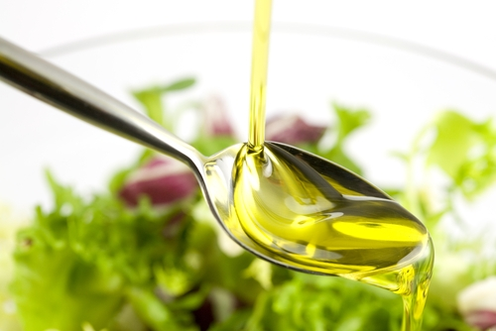
LITE HOUSE Rice Bran Oil
Fortification with Vitamins
Since, edible oil is used for daily consumption, fortification with vitamins is one of the most effective method to improve health and prevent nutritional deficiencies.
Rice bran oil has been fortified with Vitamin A & D which helps improve the nutritional quality of the food and has a profound impact on the body’s immune system.

Slide 10
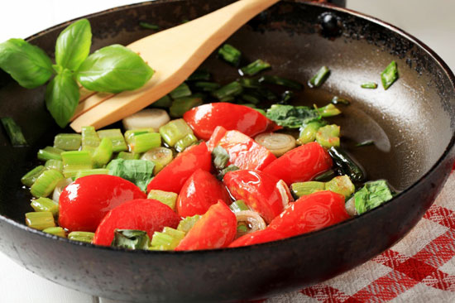
LITE HOUSE Rice Bran Oil
Suitable Oil for Cooking
High smoke point- The high smoke point prevents fatty acid breakdown at high temperatures, making it suitable for stir frying and deep frying.
Less absorption- Its light viscosity, allows less oil to be absorbed (upto 15-20% lesser) in cooking, reducing overall calories. Less oil absorbed also makes it more economical.
Less greasy-Rice Bran Oil creates less polymers (or is less greasy) than other oils meaning better flavor and easier clean-up.

Slide 11
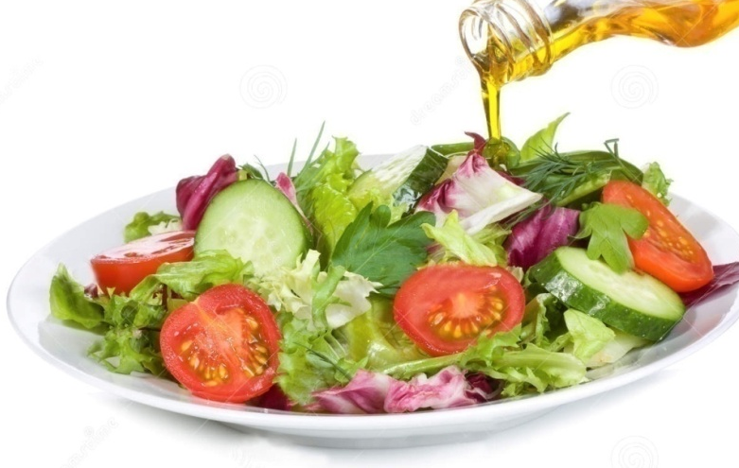
LITE HOUSE Rice Bran Oil
Advantages:
The most balanced and versatile oil, closest to recommendations of-
WHO (World Health Organization)
NIN (National Institute Of Nutrition)
AHA (American Heart Association)
2. Helps manage health of the heart
3. Nutritionally superior and high anti-oxidant value.
4. Economical – 15% less absorption of oil during frying
5. Physically refined thus bland in taste and odour
6. Superior salad, cooking, and frying oil which leaves no lingering after taste.
Rice Bran Oil is truly "The Healthiest" edible oil, containing antioxidants, nutrients and good fats.

Slide 12
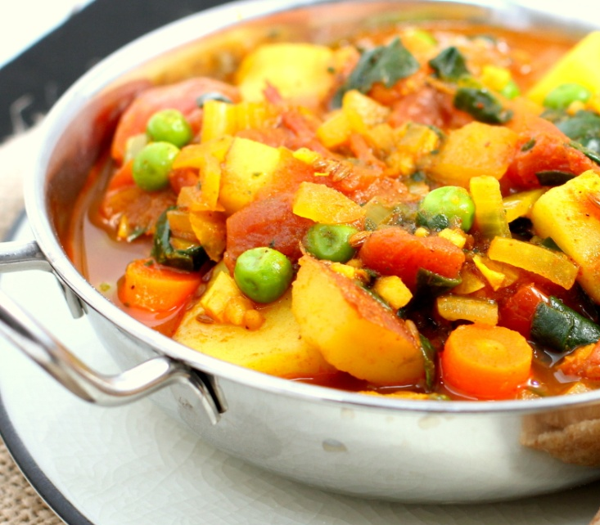
LITE HOUSE Rice Bran Oil
Taste at its best!
Apart from having the right amount of oryzanol, natural antioxidants; food cooked in Rice Bran Health Oil also tastes very good.
It has a light and neutral flavor, compatible with both, low heat as well as high heat cooking.
Therefore it is no surprise that rice bran oil is fast becoming ‘the best choice’ as a healthy cooking medium in most kitchens!!

Slide 13
Benefits of Rice Bran Oil
For a healthy heart-
Rich in heart healthy Oryzanol & unique micro-nutrients which are known to maintain healthy cholesterol levels besides promoting overall health.
When you eat a low carbohydrate diet cooked in rice Bran Health Oil, it helps reduce bad cholesterol (LDL) and improve good to bad cholesterol ratio (HDL/LDL) which is very important for heart health.
Meets “Zero” Trans-Fat standard

Slide 14
Benefits of Rice Bran Oil
Rich in Antioxidants
Due to its high antioxidant content, it fights the free radicals which in turn helps boost the immune system
Natural Anti ageing
Rich in Squalene and Vitamin E , which nourishes the skin, making your skin soft and moisturized. This effectively helps delay wrinkle formation and maintains a healthy skin tone.
Rejuvenates health
Vitamin E & Ferulic acid helps maintain nervous system and balances the hormonal levels.

Slide 15
Rice Bran Oil vs other cooking oils
Vanaspati
Sunflower Oil
Peanut Oil
Coconut Oil
Olive Oil
High levels of saturated fats (bad fat) & contains undesirable trans-fats.
Groundnut Oil (Peanut Oil) lacks some antioxidants and essential nutrients (Oryzanol & Tocotrienols)
High in calories and triglycerides, both in large amounts are bad for health.
Has near ideal fat profile but it is not suitable for frying as it has very low smoke point (180ºC) and is expensive as compared to other oils.
Very high levels of the Poly-unsaturated fats (PUFA) than the recommended levels.
Rice bran oil
Balanced fatty acid profile
Full of antioxidants and essential nutrients
Helps in maintaining a healthy heart.

Slide 16
In order to judge any oil as healthy, there are two parameters required: 1. Ratio of Saturated fats to unsaturated oil (MUFA/PUFA) 2. Presence of antioxidants.
Rice Bran Oil vs other cooking oils
 | Fatty acid % by weight |  |  | Total natural antioxidants (ppm)
 | Saturated fats | PUFA | MUFA
Recommended by NIN (National Institute Of Nutrition) | 27-33% | 27-33% | 33-40%
Rice bran oil | 24 | 34 | 42 | 2417
Vanaspati | 60 | 0 | 40 | negligible
Sunflower oil | 12 | 69 | 19 | 487
Palm oil | 50 | 10 | 40 | 405
Soybean oil | 15 | 61 | 24 | 1000

Slide 17
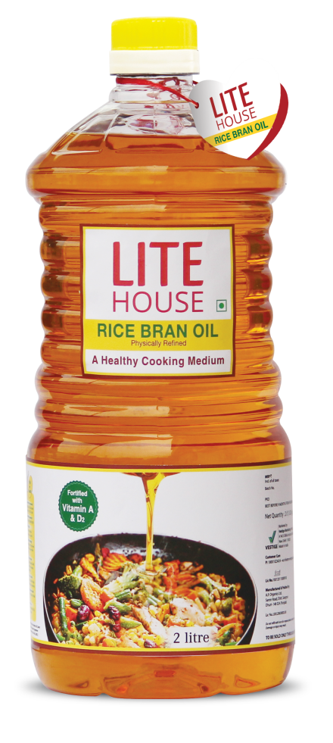
LITE HOUSE Rice Bran Oil
Net content- 2 litres

Slide 18
Thank You

